Slide 1
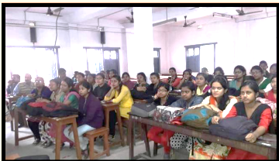
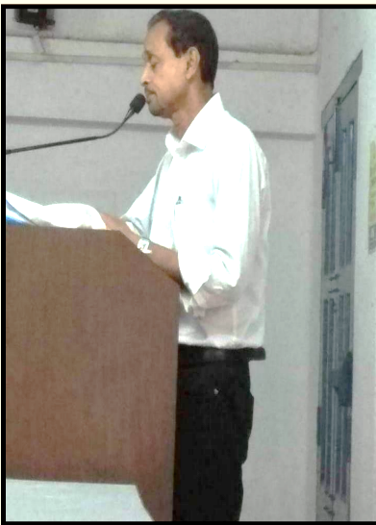
Session: 2017- 2018
Event Name | Date | No. of Participants | Description
Extension Lecture | 15/09/2017 | 60 (approx.) | Lecture given by Dr. Ajit Kumar Sil, Associate Professor, Bhairab Ganguly College on Social Disaster: Issues and Development
CORRESPONDING PHOTOS WITH EVENT NAME:
Extension Lecture by Dr. Ajit Kumar Sil

