Slide 1
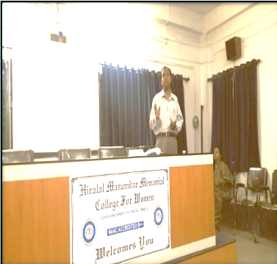
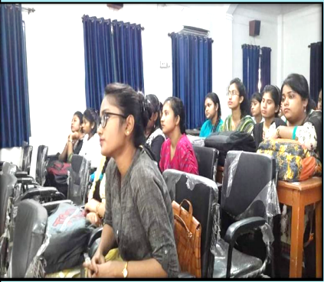
Session: 2018- 2019
Event Name | Date | No. of Participants | Description
Extension Lecture | 03/06/2018 | 48 (approx.) | Lecture given by Dr. Iqbal Sultan, Assistant Professor, Gokhel Memorial College on the correct way to write model answer
CORRESPONDING PHOTOS WITH EVENT NAME:
Extension Lecture by Dr. Iqbal Sultan

