Slide 1
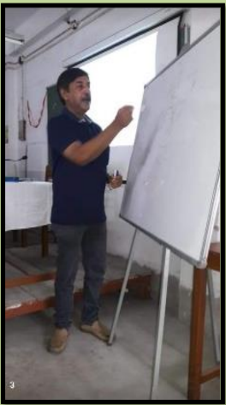
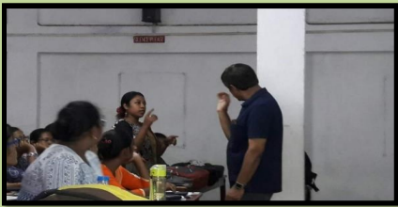
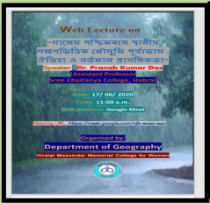
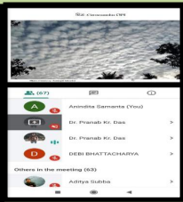
Session: 2019- 2020
Event Name | Date | No. of Participants | Description
Extension Lecture | 04/09/2019 | 65 | Lecture given by Dr. Partha Basu, Associate Professor of Bhairab Ganguly College On Universal Transverse Marcator Projection
Webinar | 13/06/2020 | 110 | Speech delivered by Dr. Pritam Aich, Assistant Professor, Jadavpur University on Disaster Management
Webinar | 17/06/2020 | 60 | Speech delivered by Dr. Pranab Kumar Das, Assistant Professor, Sree Chaitanya College Habra on “Gangeyo Paschimbonge Mousumi Jolobayur Purbavas o Prasangikota”
CORRESPONDING PHOTOS WITH EVENT NAME:
Extension Lecture by Dr. Partha Basu
Webinar by Dr. Pranab Das & Dr. Pritam Aich

