Slide 1
Session: 2020- 2021
Event Name | Date | No. of Participants | Description
State Level Online Geo- Quiz | 06/08/2020 | 331 | A quiz on geographical aptitude was held on through a Google form. Students of U.G, P.G and Research Scholar have participated there
State Level Online Poster Making Competition | 16/09/2020 | 42 | Students from different schools, colleges and universities have submitted poster to observe “Global Ozone Day”. These posters were being judged on the basis of their ideas and presentations.
Webinar | 03/10/2020 |  | Speech given by Prof. Lakshminarayan Satpati, University of Calcutta on “Environment and Development Under the COVID 19 New Normal- The Indian Perspective”
State level Online Poster & Map Making Competition | 06/12/2020 | 19 | Students from different schools, colleges and universities have submitted poster to observe “World Soil Day”. These posters were being judged on the basis of their ideas and presentations.
Webinar | 27/02/2021 | 67 | Speech delivered by Dr. Priyank Pravin Patel, Assistant Professor, Presidency University
Special Lecture and Online Debate Competition in collaboration with East Calcutta Girls’ College | 22/04/2021 | 27 | Special lecture delivered by Dr. Sukla Hazra, Principal, East Calcutta Girls’ College on “Assessment of Earth Restoration: Practice and Problems” followed by an online debate competition between the students of the Department of Geography of H.M.M College For Women and East Calcutta Girls’ College
Intra- mentoring Group video making competition | 30/06/2021 | 8 mentoring groups | A video makng competition was held on through Google form where students belonging to the mentoring groups have been participated on the theme “Explore Your Creativity”.

Slide 2
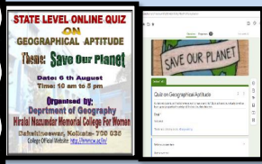
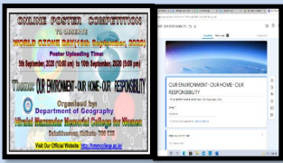
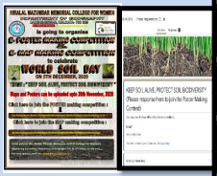
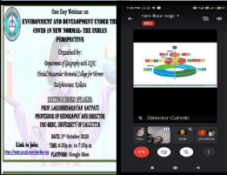
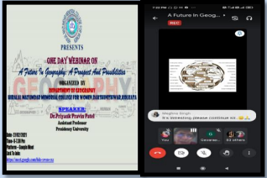
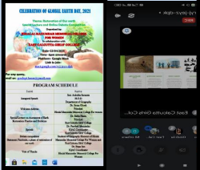
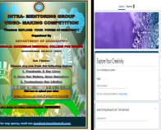
CORRESPONDING PHOTOS WITH EVENT NAME:
Online Geo- Quiz
Online Poster Contest on
World Ozone Day
Online Poster Contest on
World Soil Day
Webinar by
Prof. L. N. Satpati
Webinar by
Prof. P. P. Patel
Online Debate Contest & Web Talk on World Earth Day
Intra- Mentoring
Video Making contest

