Slide 1
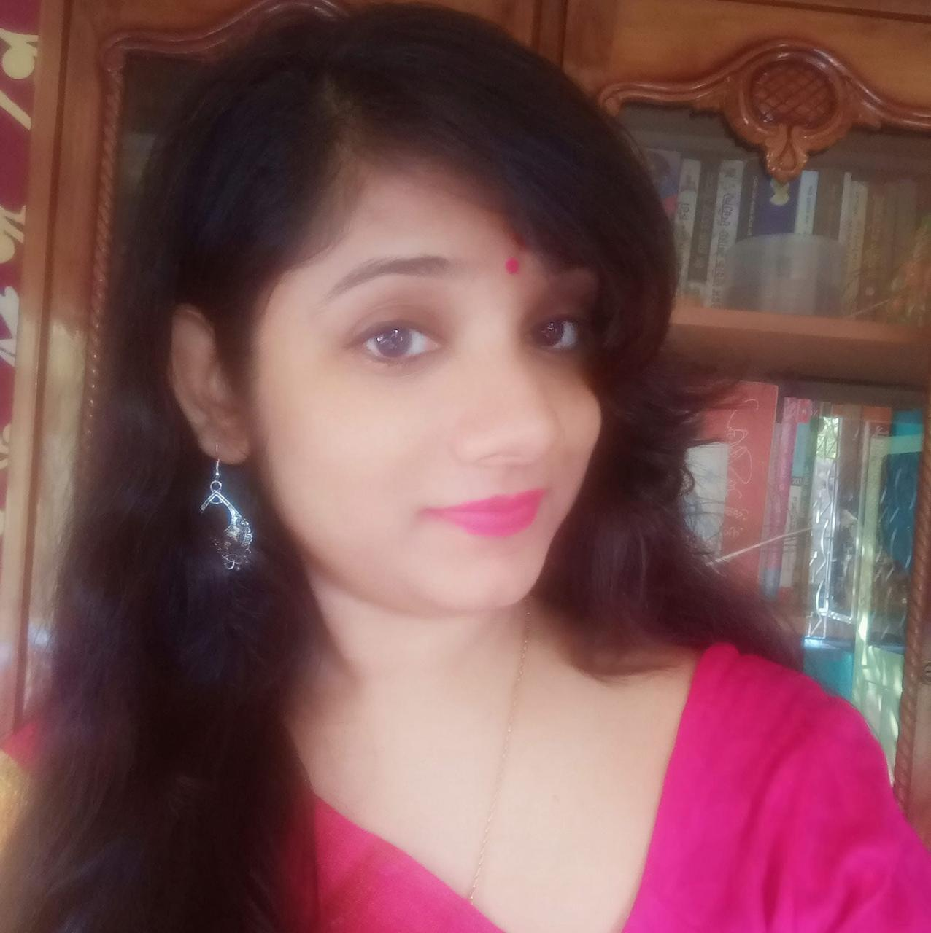

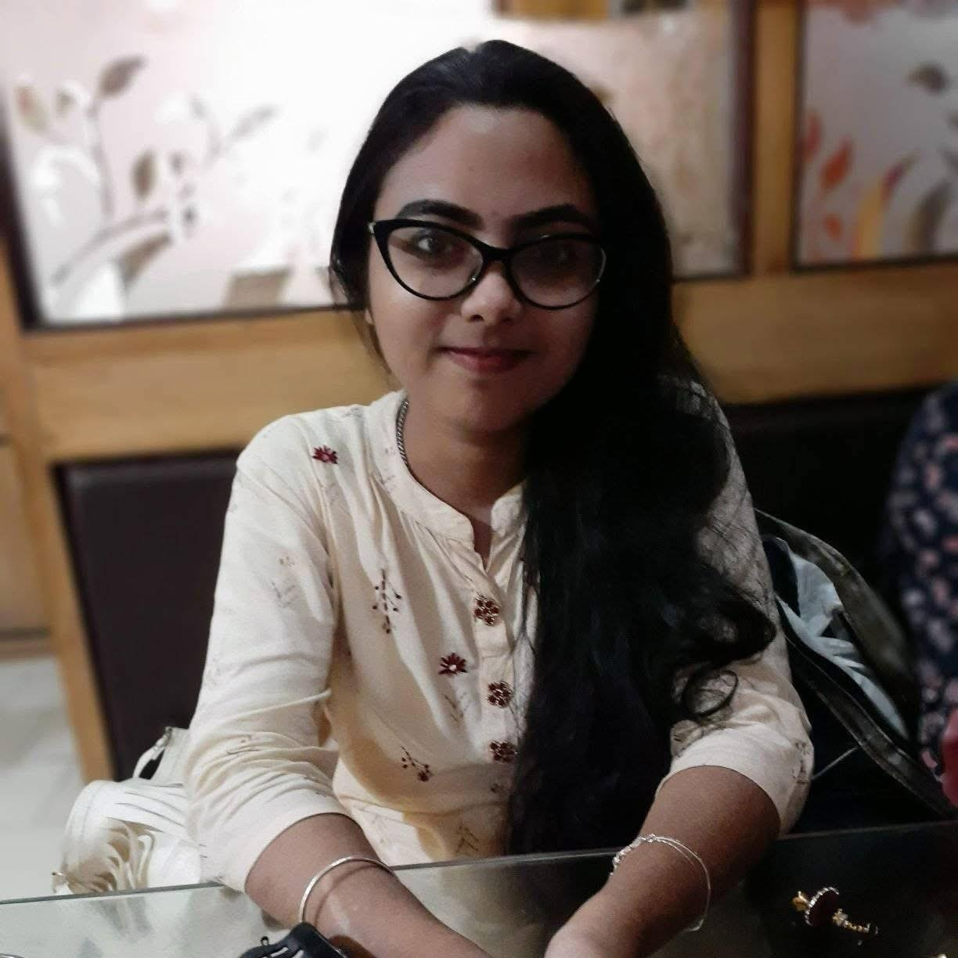
Alumni Students’ Achievements in National Examination
Name of the Students | Achievement | NET Passing year | Photo
Priyanka Ghosh | UGC NET –JRF (Roll No-91028847)2018 Joined Rajabazar Science College Calcutta University , as a Research Fellow From CU https://drive.google.com/file/d/1Oh528WnXhVG18btJ0scDYXN1xQrIFmHz/view?usp=drive_link | 2018
Suparna Paul | UGC NET –LS 2020 (WB1051800577) Worked as a facilitator in Department of Food and Nutrition.(2021-2022) https://drive.google.com/file/d/12agoYL9CpEjuGMItwKIth-9hfqFX-dap/view?usp=sharing | 2020
Souradipta Chakraborty | UGC NET –JRF (Roll No-WB0651800007) 2020 Joined Calcutta University , as Research Fellow from February 21 https://drive.google.com/file/d/1pGucSlbrRfAcQJ0goo-xk-5lNNdH4nJ7/view?usp=drive_link | 2020

Slide 2
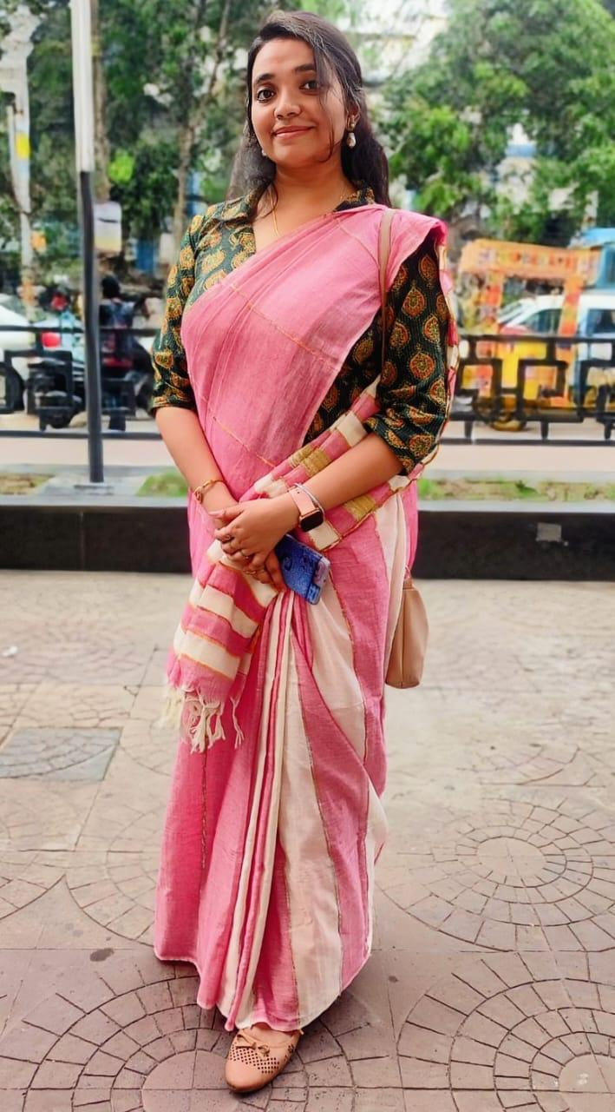
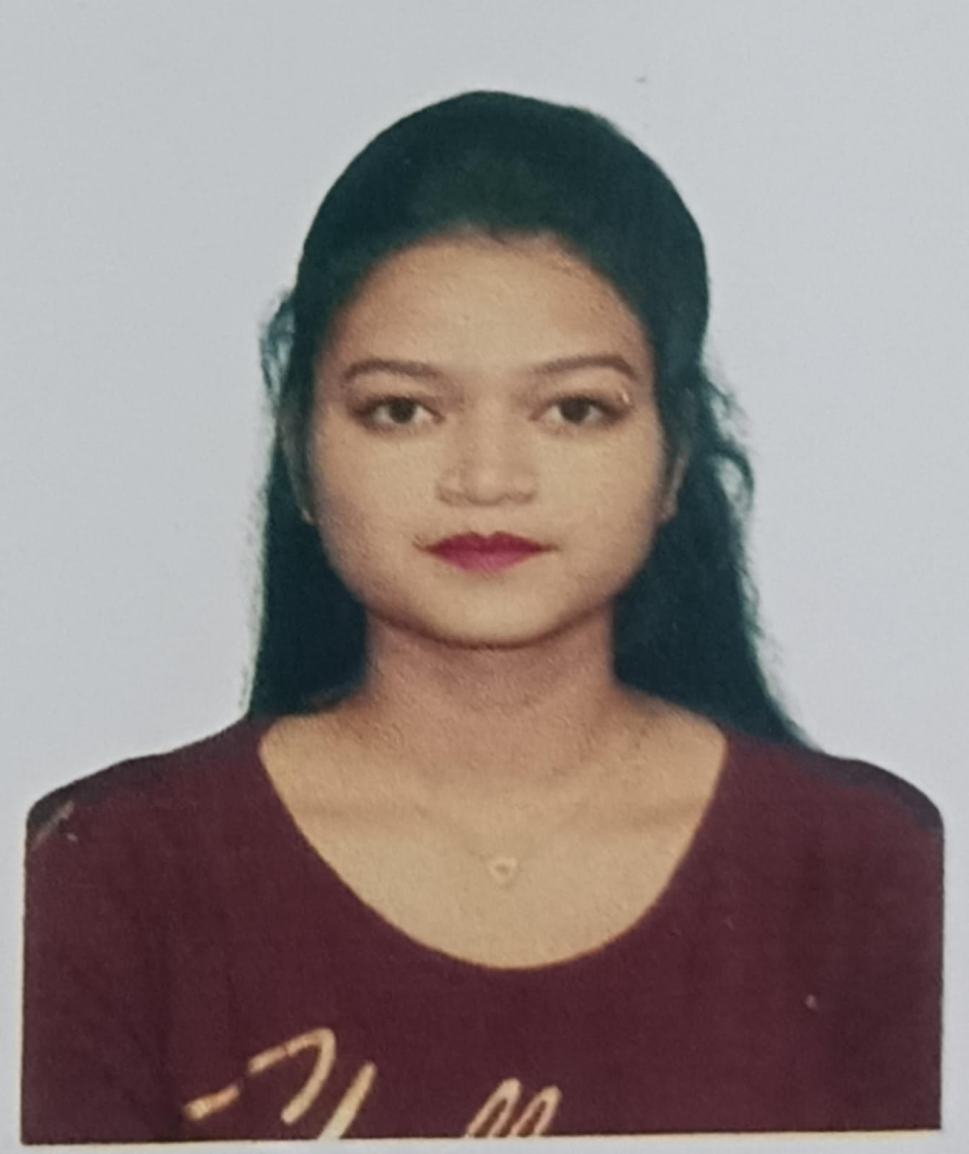

Alumni Students Achievements in National Examination
Name of the Students | Achievement | NET Passing year | Photo
Swetanjana Ghosh | NET – JRF Worked as a facilitator in Department of Food and Nutrition.(2021-2022) Joined Jadavpur University, as Research Fellow from April 22 https://drive.google.com/file/d/1tab3mFOA9kYCBL5aOVdfMWPQS9Dg5aMW/view?usp=sharing | 2021
Priti saha | NET FOR Admission of PhD ROLL NO. : 4608002884 Passing year- 2024 June https://drive.google.com/file/d/1Fupz83HS6xq0dGTH_9ik8Kf_Z1lQFPB3/view?usp=sharing | 2024 june
Shelly mondal | NET FOR LS AND JRF https://drive.google.com/file/d/1QRLtGKMzkdCtj9tGYKerxwWtGmRxBRSY/view?usp=sharing | 2024

Slide 3
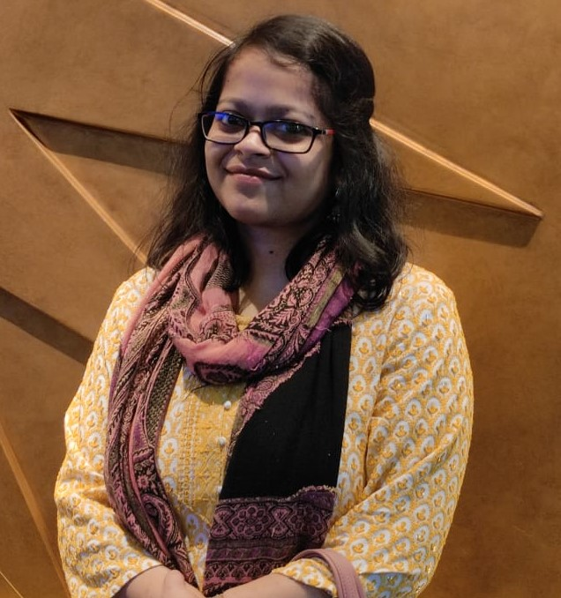
Alumni Students Achievements in National Examination
Name of the Students | Achievement | NET Passing year | Photo
Debapriya Roy Chowdhury | NET – LS https://drive.google.com/file/d/1mx5eNthWB-BqmsC-NVCt4xkIFvVKuLM5/view?usp=sharing | 2023

