Slide 1
DEPARTMENTAL ACTIVITIES
FOOD AND NUTRITION

Slide 2
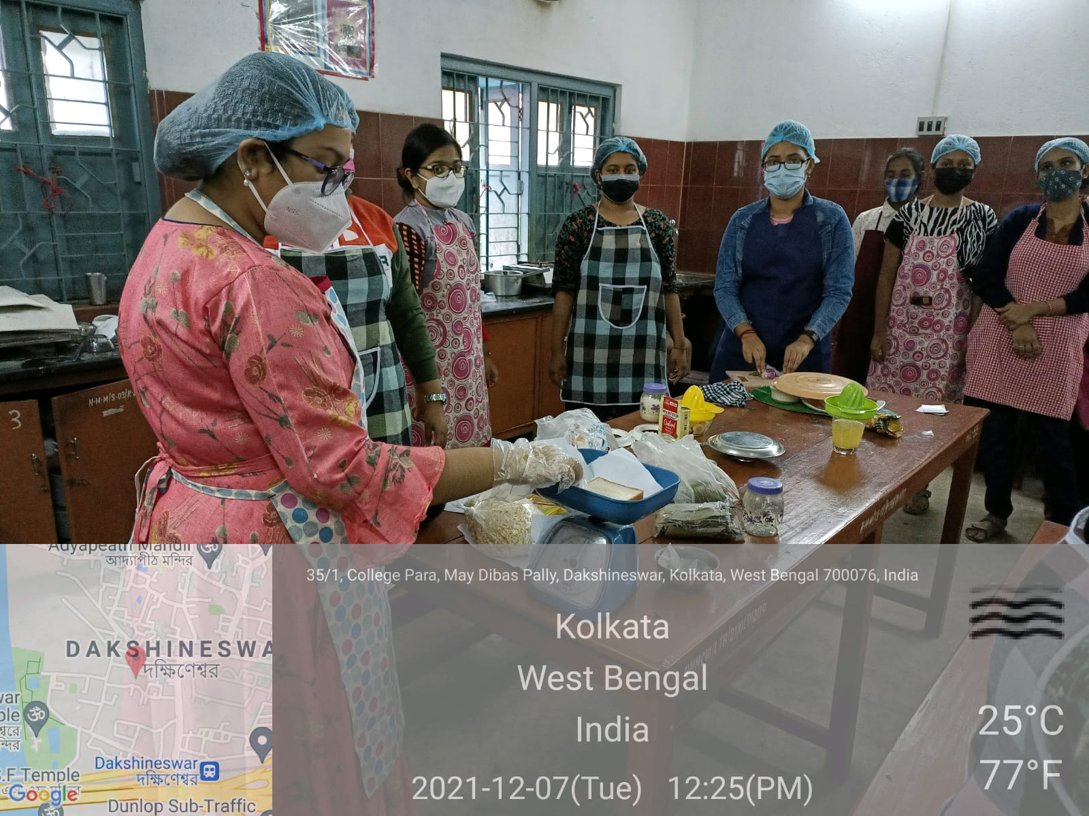
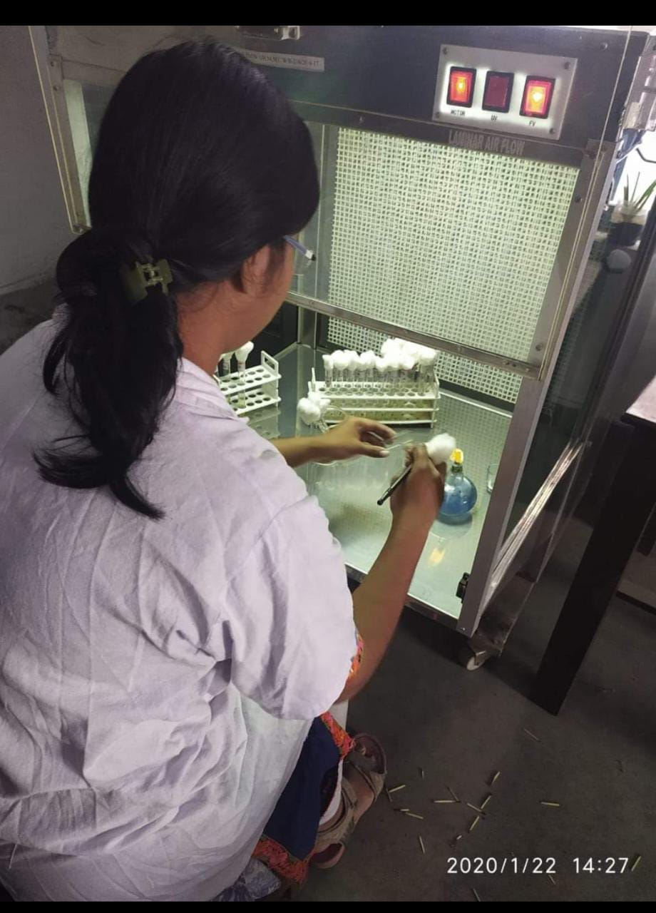
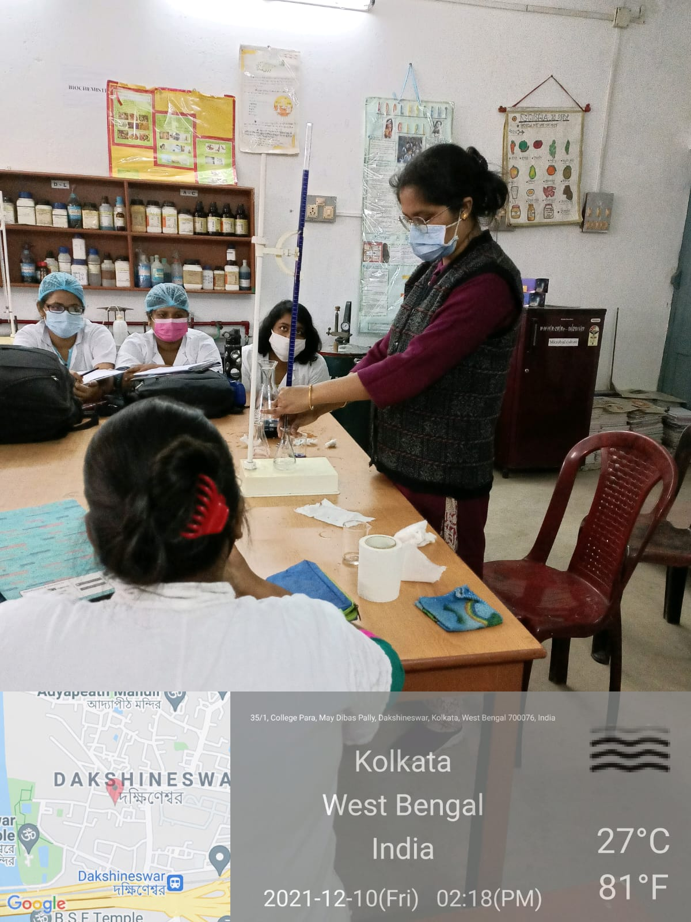
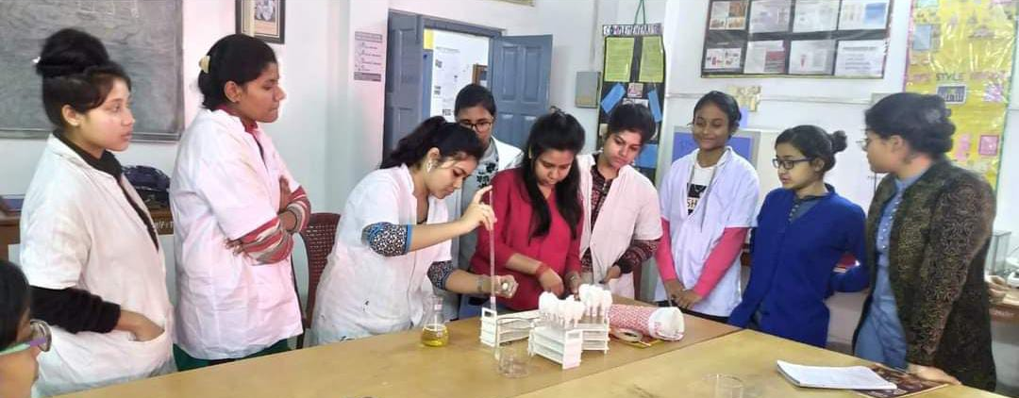
Distinctive Features of the Department
Interdisciplinary And Job Oriented Subject.
Physiology, Biochemistry Microbiology And Cookery Lab For The Students.
Inter Departmental Classes Run With Department Of Physiology, Chemistry, Environment Science, Commerce, Economics, Botany Of Hiralal Mazumdar Memorial College For Women Dakshineswer .
Regular Theory and practical classes for the students.

Slide 3
Distinctive Features of the Department
ICDS, Slum Area Visit And Assessment Of Their Nutritional Status As Apart Of Curriculum
Participation of students and faculties In Different Workshops Webinars And Seminars
Extension/Special Lectures By Renowned Professors Of Different Universities And Colleges
Educational Industrial Visit.
Internship Programme To A Reputed Hospital Of Dietetic Department Kolkata.
National Nutrition Month, Breastfeeding Week, World Diabetes Day Celebration.
Organising Health And Nutrition Camps And Nutrition Education To The Common People.
Free Diet Center For Diet Counselling For All.

Slide 4
Distinctive Features of the Department
Syllabus Distribution & Academic Calendar
Distribution of syllabus by the Head of the Department among the teachers. And academic calendar is given to the student at the beginning of the new session where tentative time of completion of each topic is mentioned.
Academic plan of action
Tentative layout of academic plan of action through out the session are mentioned and displayed on the departmental notice board.
Regular Parents Teachers Meeting

Slide 5
Academic monitor
To keep records of the topic taught in the class along with number of classes including respective teacher and students signature.
Monitoring of students:
Student- Teachers interaction through interactive classes.
Home assignments given to pupil and keeping a record of them.
Individual counselling if needed
Class test
Internal examination
Library and Tutorial classes . Total tutorial class taken last 5 years by the department :- 191
Practical classes.
Remedial classes for slow learner. Total remedial class taken last 5 years by the department :-
Clarifying concepts with simple illustrations.
Giving Handouts
Brief outline of answer
Model questions
Reference materials

Slide 6
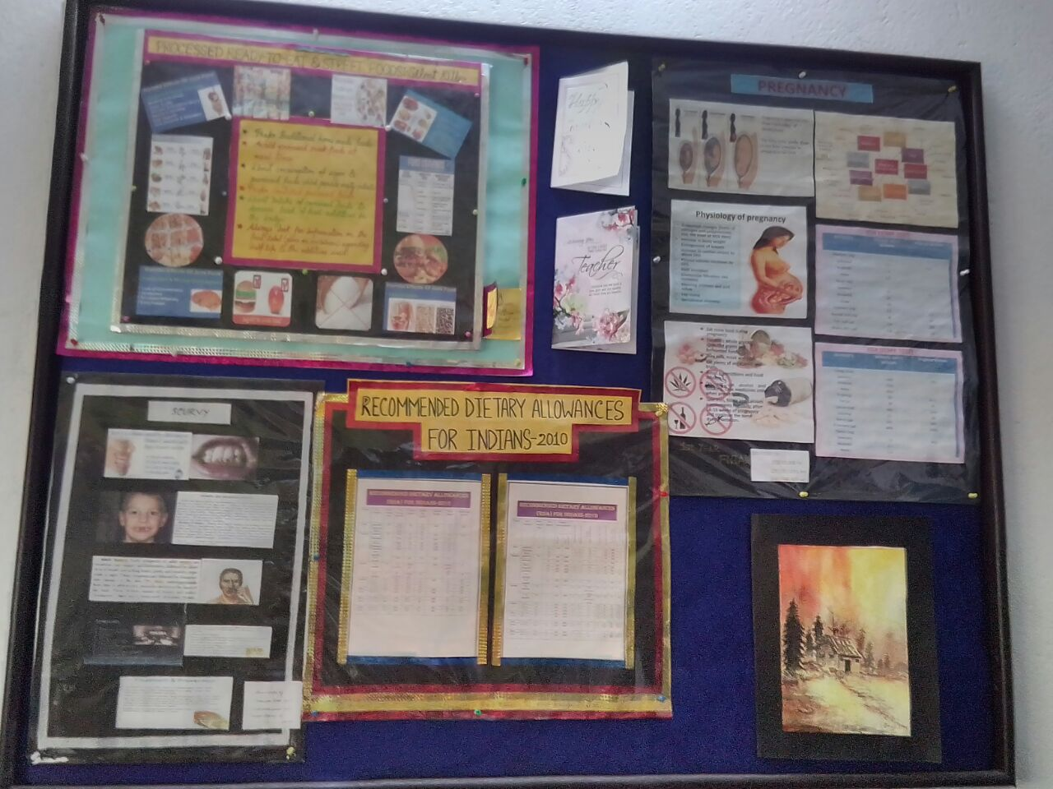
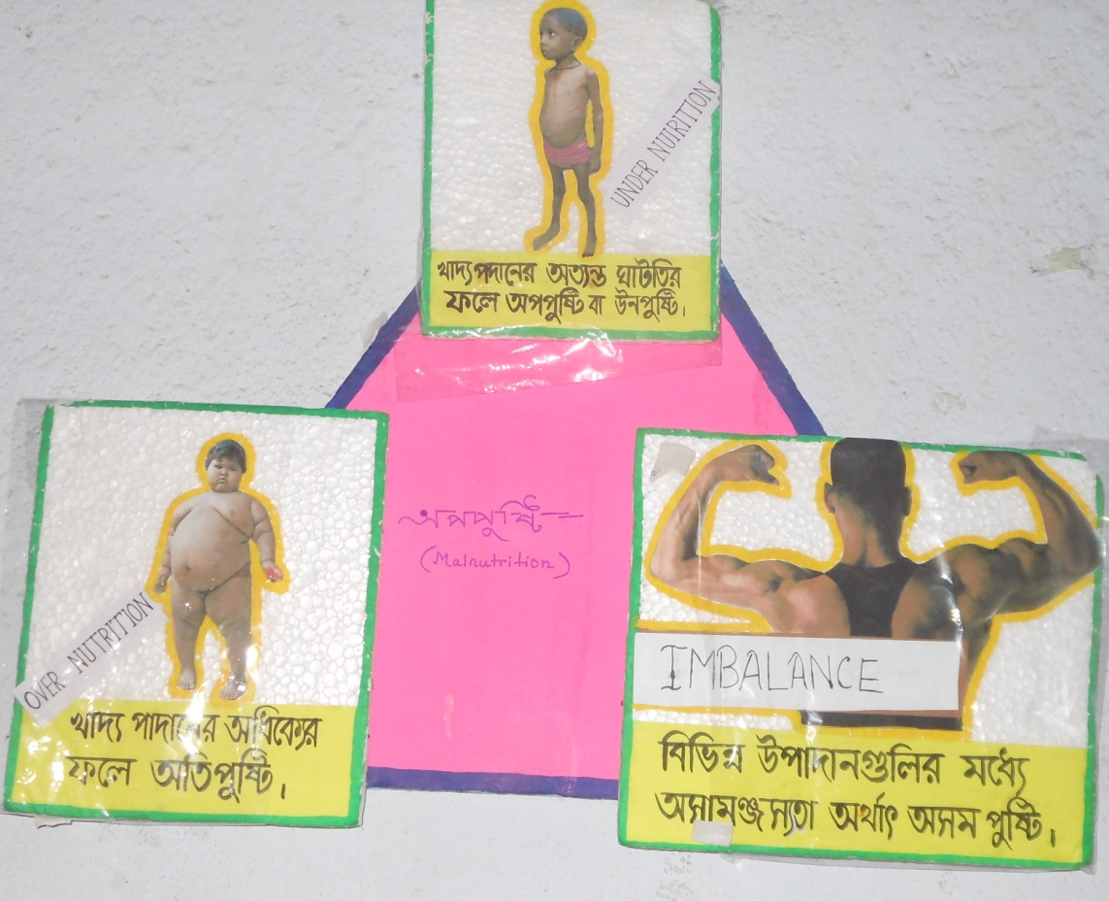
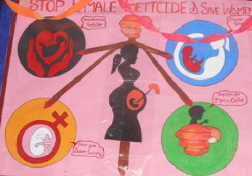
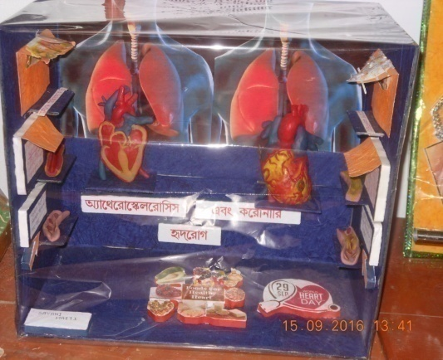
Details of Infrastructural facilities
4 faculties of Food & Nutrition
A furnished departmental room
A well equipped departmental seminar library
2 well equipped laboratories
1 allotted classroom
1 seminar library , Total book 65

Slide 7
CAREER OPPORTUNITY
Dietitians are experts in food and nutrition whose purpose is to optimise the health and nutrition of the population. The job opportunities are many. They can
Become dietitian in hospital
Work at health clubs
Join in hotel industry
Join in gym and sports club
Join in noon meal centres at the planning levels
Join large food stores chains
Work in food and pharmaceutical industry
Join in product development of food industry
Plan healthy meals for corporate bodies
Join as consultant to super markets and speciality food store

Slide 8
CAREER OPPORTUNITY
Do research on the effect of new foods on the body
Take up teaching as career after completing post graduation and passing eligibility test conducted by UGC.
Join as nutrition experts in international organisations such as UNICEF, WHO , FAO etc
Take hospital management as career.

Slide 9
STUDENTS PROFILE AT A GLANCE

Slide 10
RESULTS OF 6 YEARS
(DEPARTMENT OF FOOD AND NUTRITION)
SL NO | Year | No. of Student | No. Of Qualified Students | Percentage
1 | 2018 | 19 | 19 | 100
2 | 2019 | 20 | 17 | 85
3 | 2020 | 26 | 26 | 100
4 | 2021 | 35 | 35 | 100
5 | 2022 | 38 | 38 | 100
6 | 2023 | 34 | 34 | 100
https://drive.google.com/drive/folders/1N2LwEremoIvqKnuYsEtpgdpBeZG8DtUT?usp=drive_link

Slide 11
STUDENT PROGRESSION AT A GLANCE
SESSION | POST GRADUATION | OTHER PROGRAMMES | JOB
2017-18 | 66.67% | 26.66% | 33.33%
2018-19 | 55.56% | 16.66% | 5.56%
2019-20 | 60% | Nil | 5%
2020-21 | 71.88% | 6.25% | Nil
2021-22 | 61.76% | 2.94% | 17.65%

Slide 12
BEST PRACTICES
HEALTH UNIT FOR ALL STUDENTS
FREE DIET COUNSELLING CENTRE FOR ALL STAFF AND STUDENTS
7 DAYS INTERNSHIP AT DIETETIC DEPARTMENT OF SVS MARWARI HOSPITAL AND INHAND EXPERIENCES IN MAKING DIET CHART OF A PATIENT
CELEBRATION OF NATIONAL NUTRITION MONTH EACH YEAR ON THE MONTH OF SEPTEMBER ( Co –curricular)
PUBLICATION OF E MAGAZINE “NUTRIDYNAMICS”
CONTND……..

Slide 13
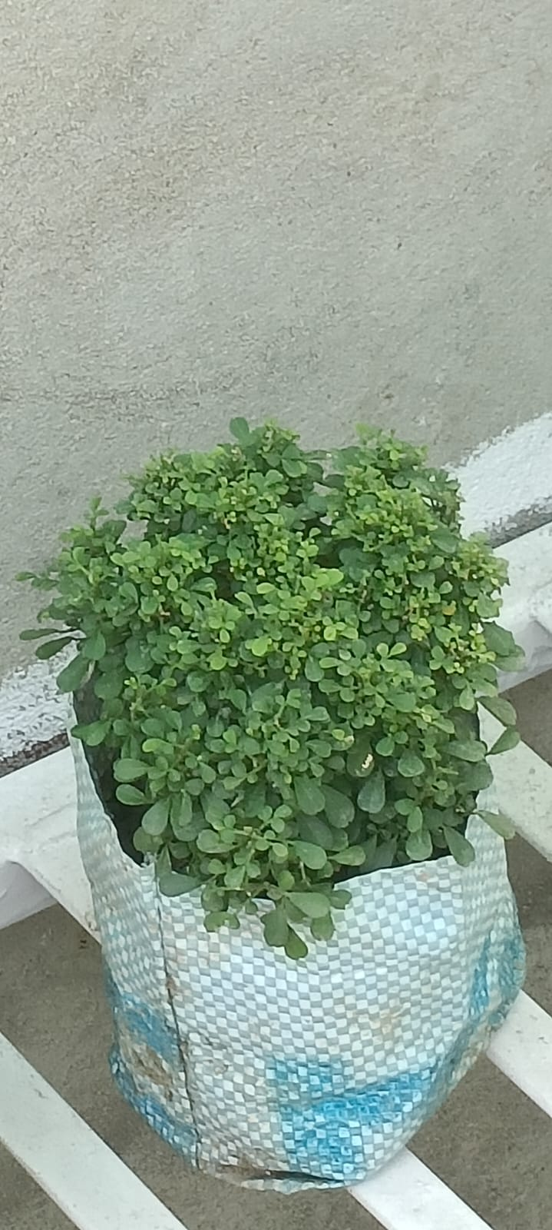
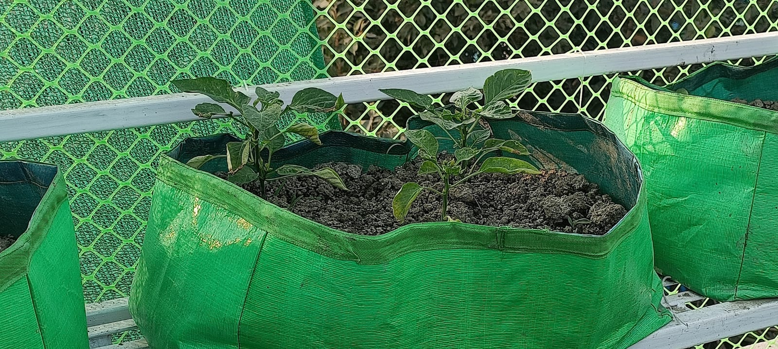
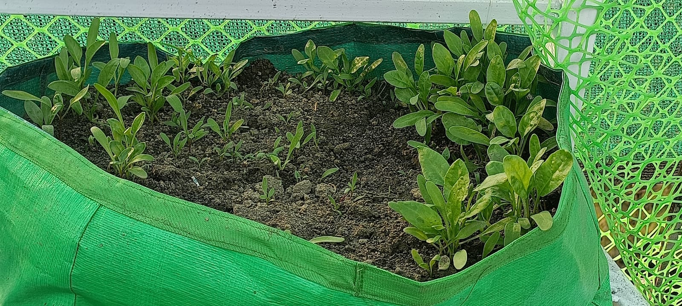
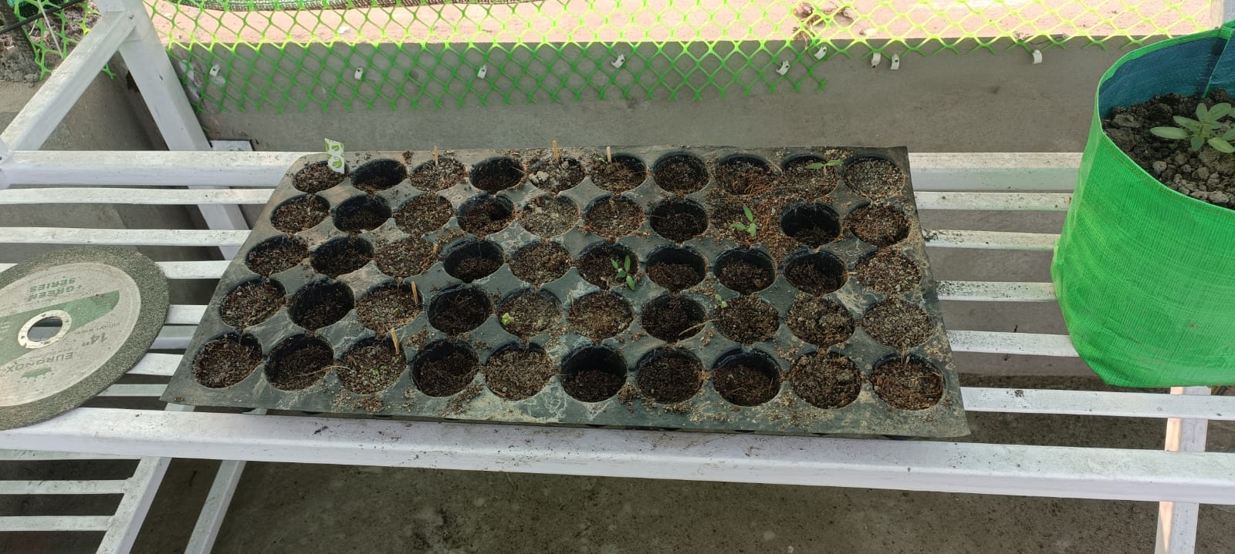
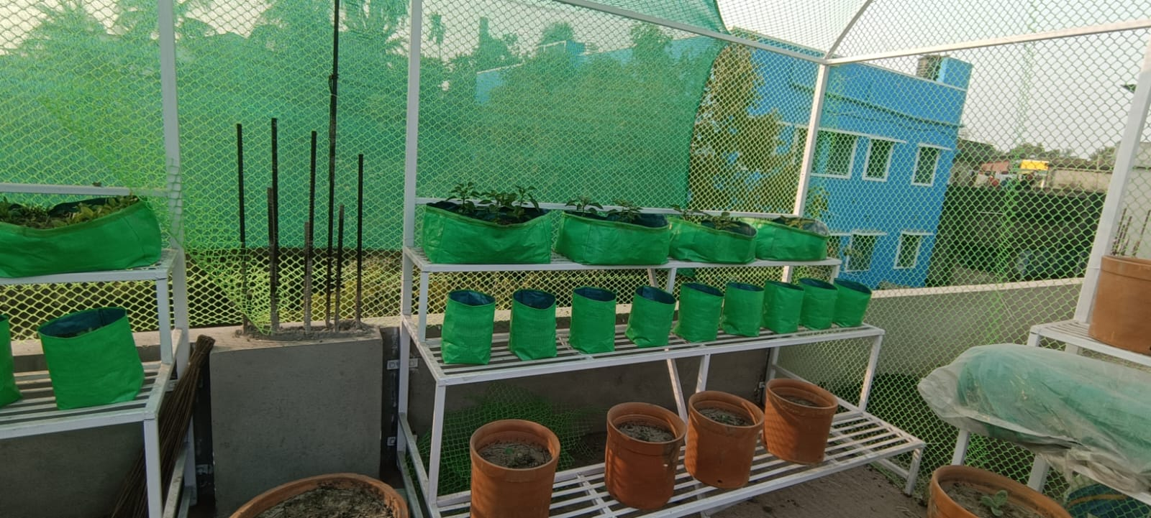
PRESENTING KITCHEN GARDEN
BY FOOD AND NUTRITION DEPARTMENT
ITS AN INITIATIVE TAKEN FROM 2022 FOR MAKING GREEN CAMPUS AND ALSO USE THE VEGETABLES GROWN AT KITCHEN GARDEN AS AN INGREDIENT OF COOKING FOR HEALTHIER LIVES AND TO FIGHT AGAINST MALNUTRITION THROUGH PROPER NUTRITION.

Slide 14
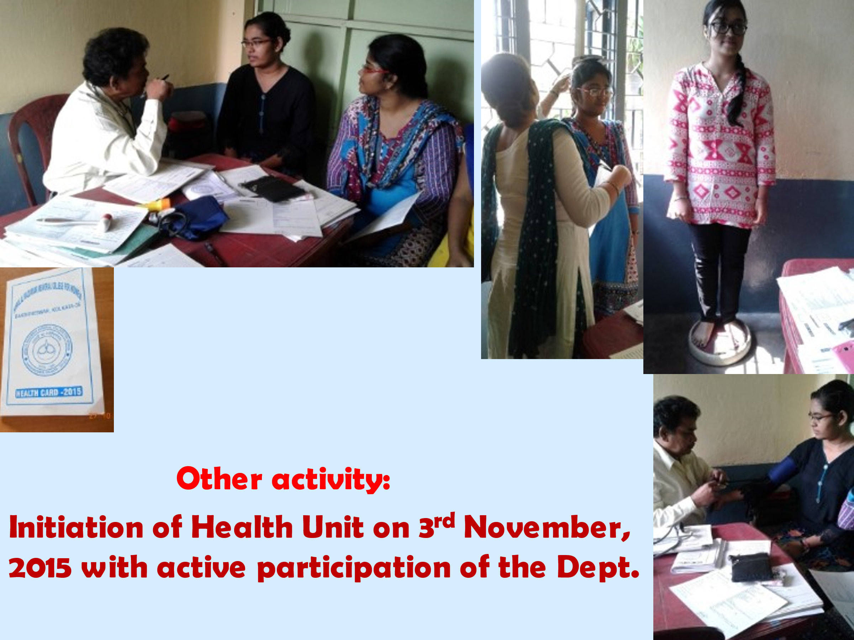

Slide 15
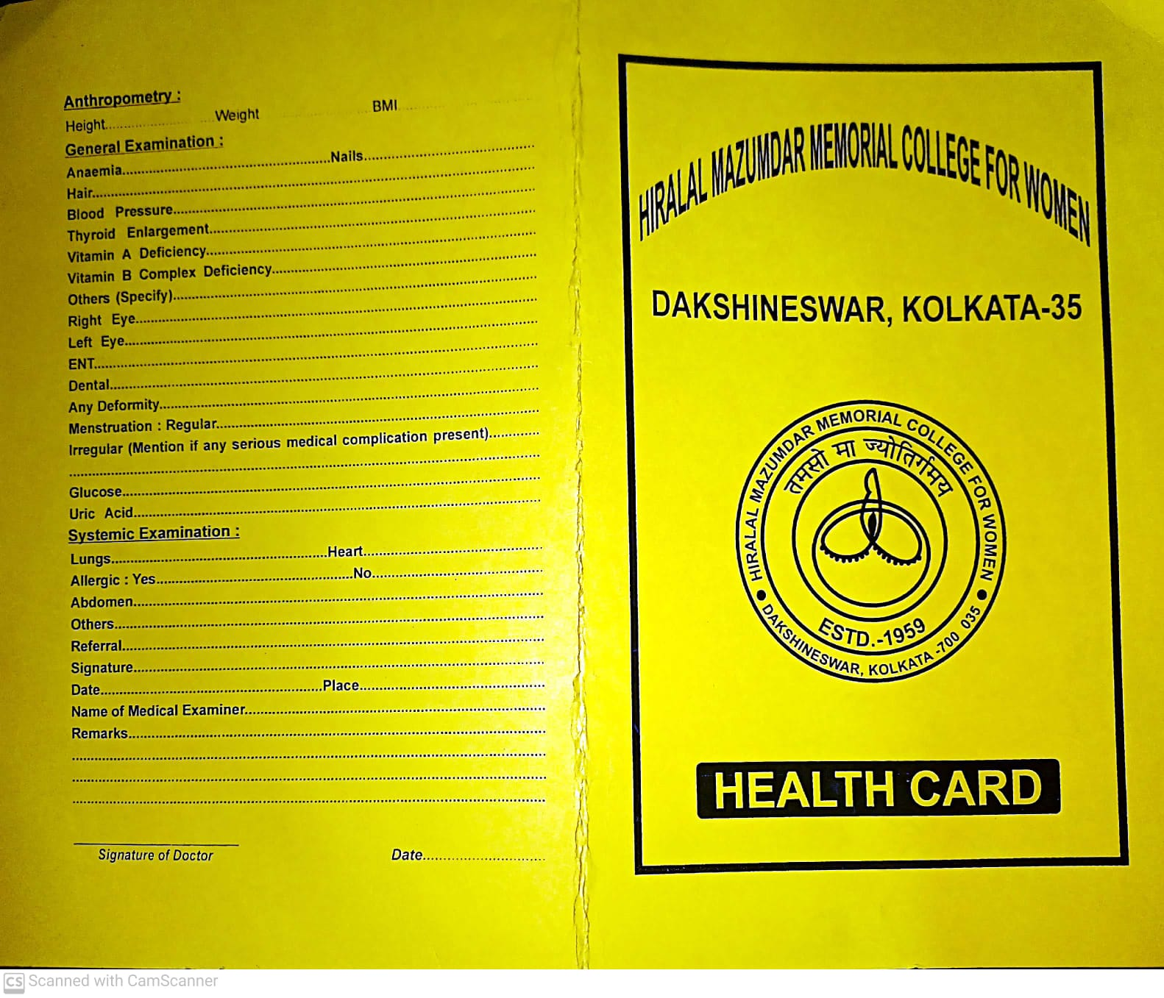
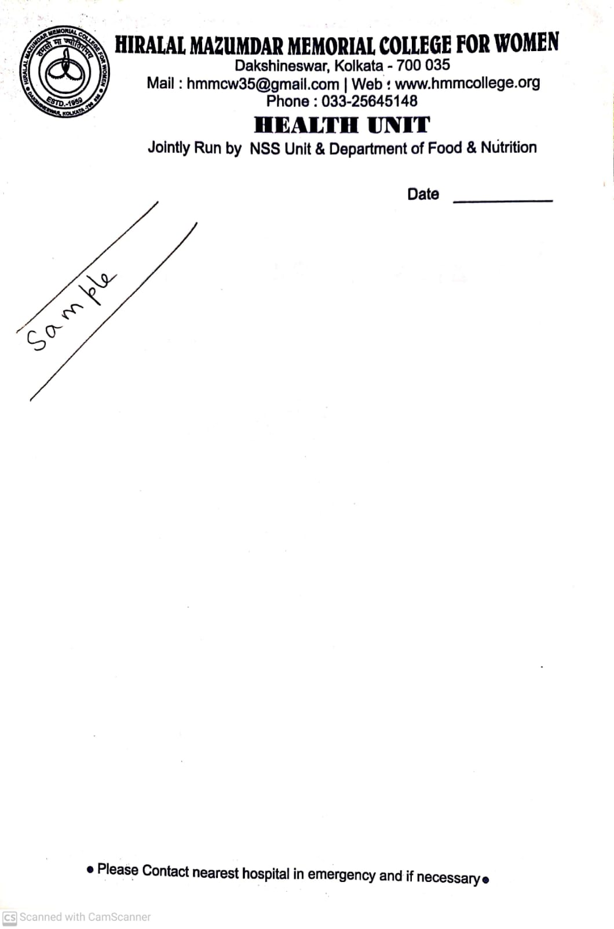
TOTAL NO OF STUDENTS BENEFITED AT HEALTH UNIT RUN BY
DEPARTMENT OF FOOD AND NUTRITION
SL NO | YEAR | TOTAL BENEFICIARY NO
1 | 2017 | 183
2 | 2018 | 64
3 | 2019 | 225
4 | 2020 | 56
5 | 2021 | -
6 | 2022 | 359
7 | 2023 | 217

Slide 16
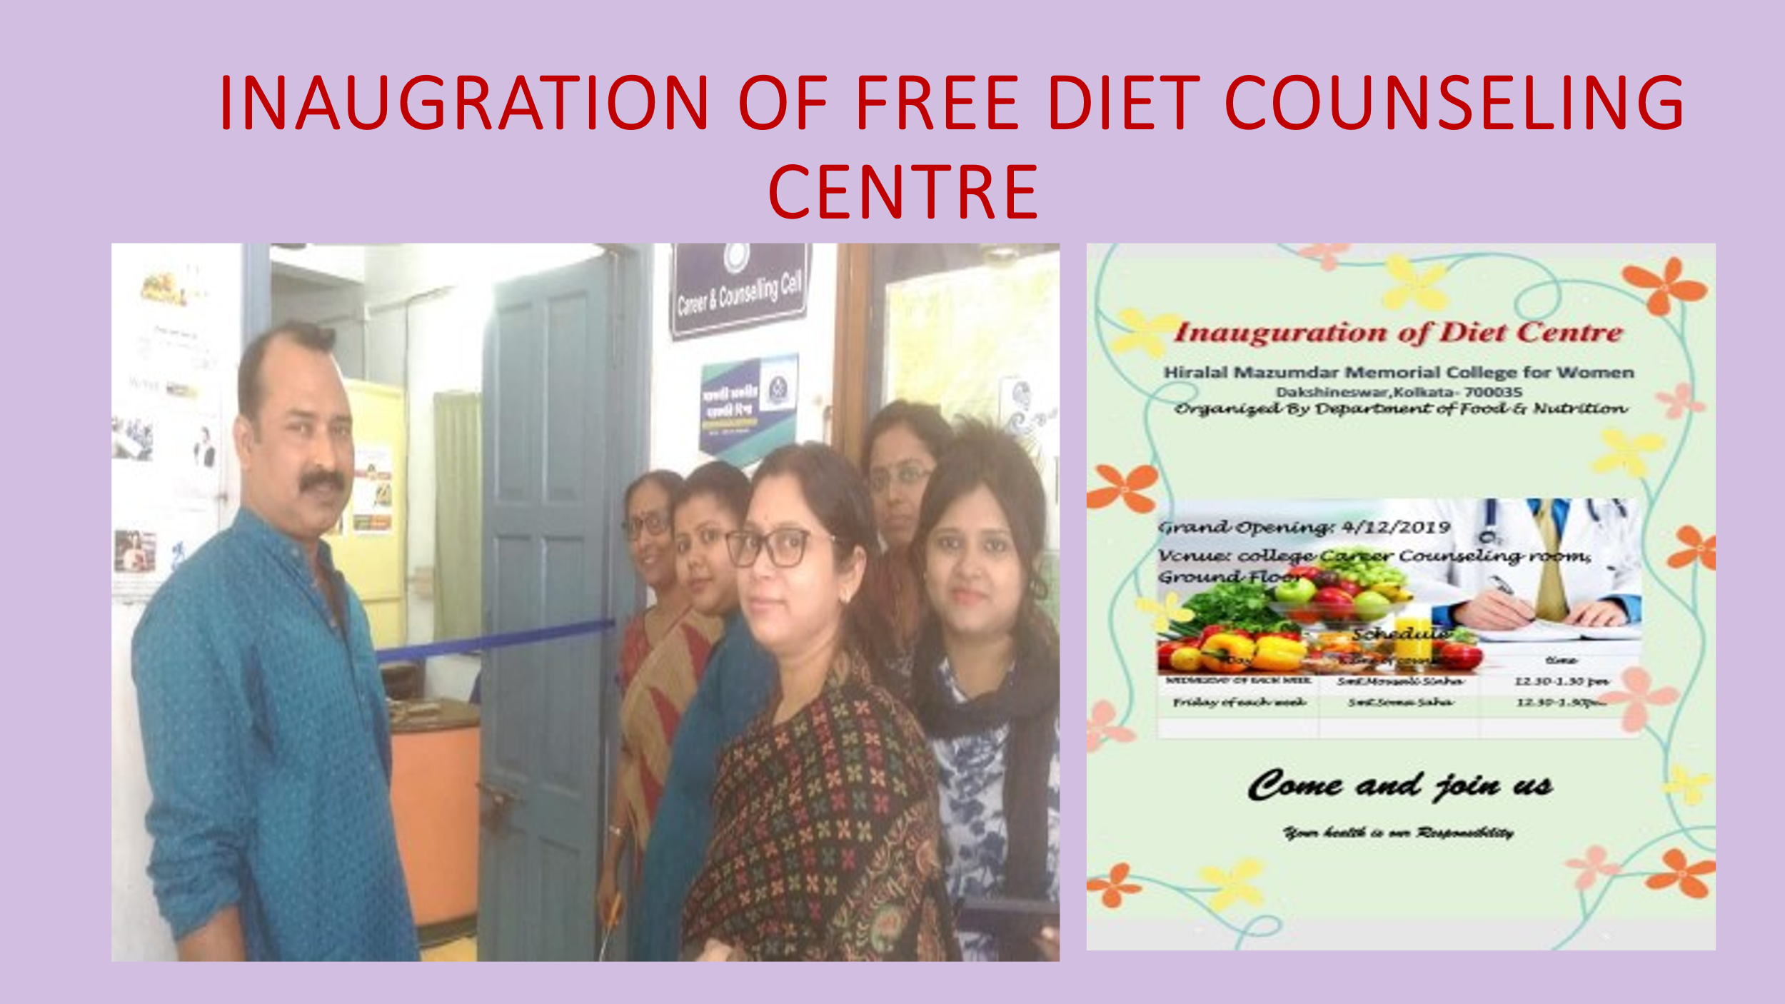

Slide 17
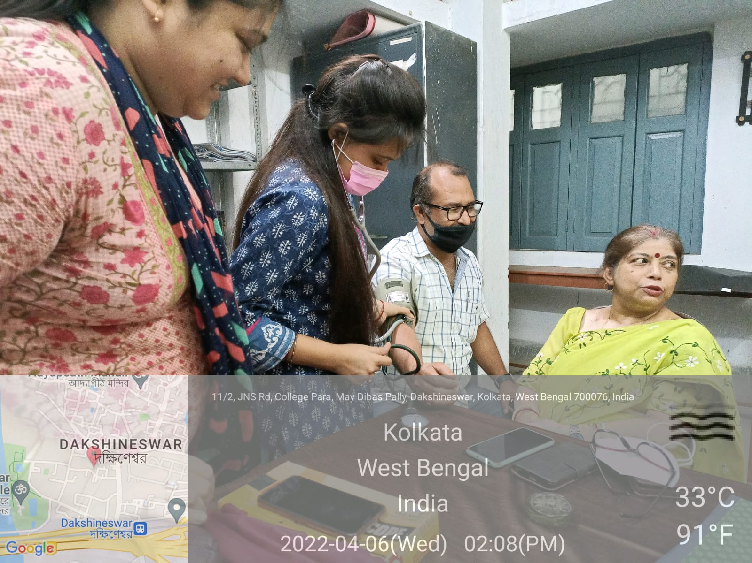
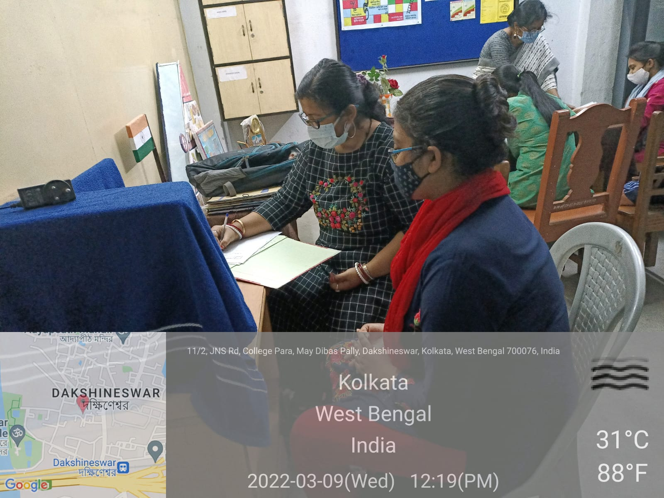
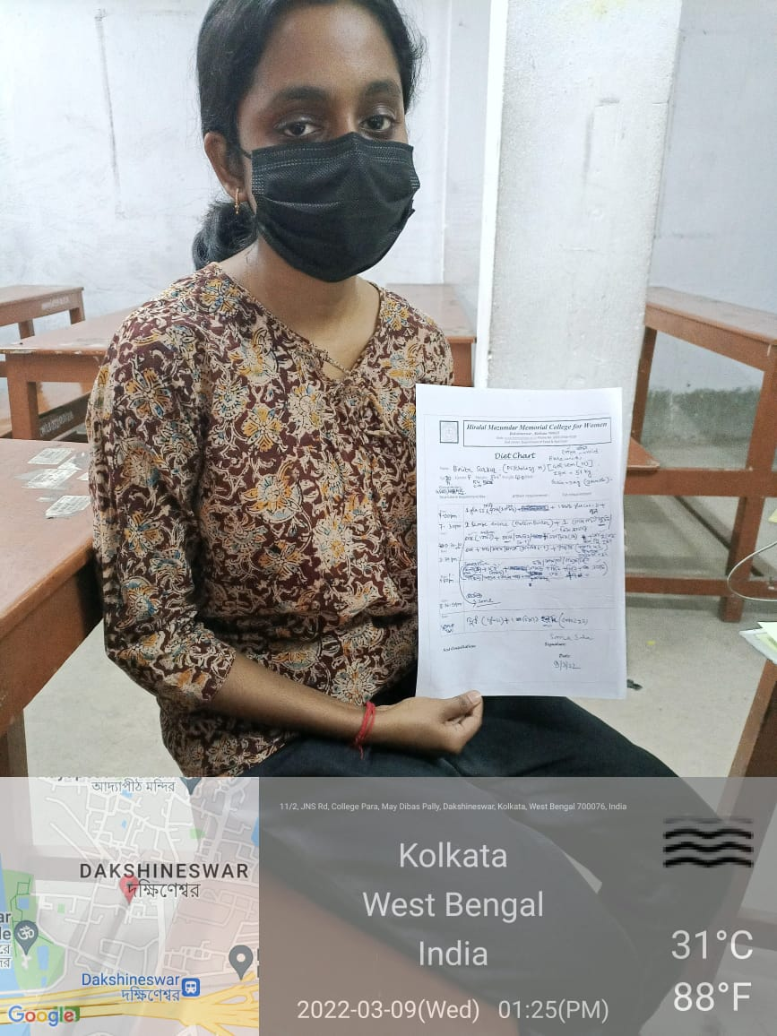
FREE DIET COUNSELING FOR ALL STUDENTS AND STAFF

Slide 18
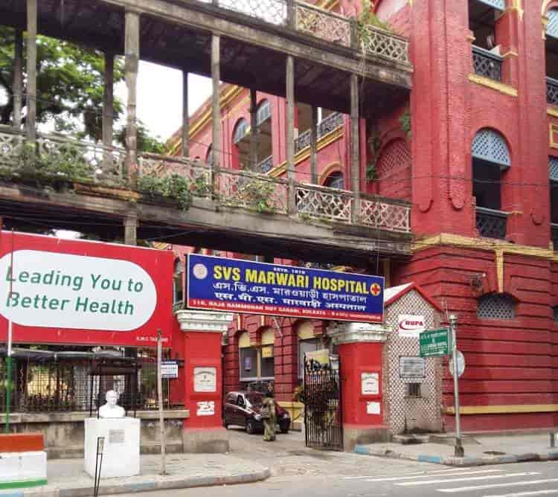
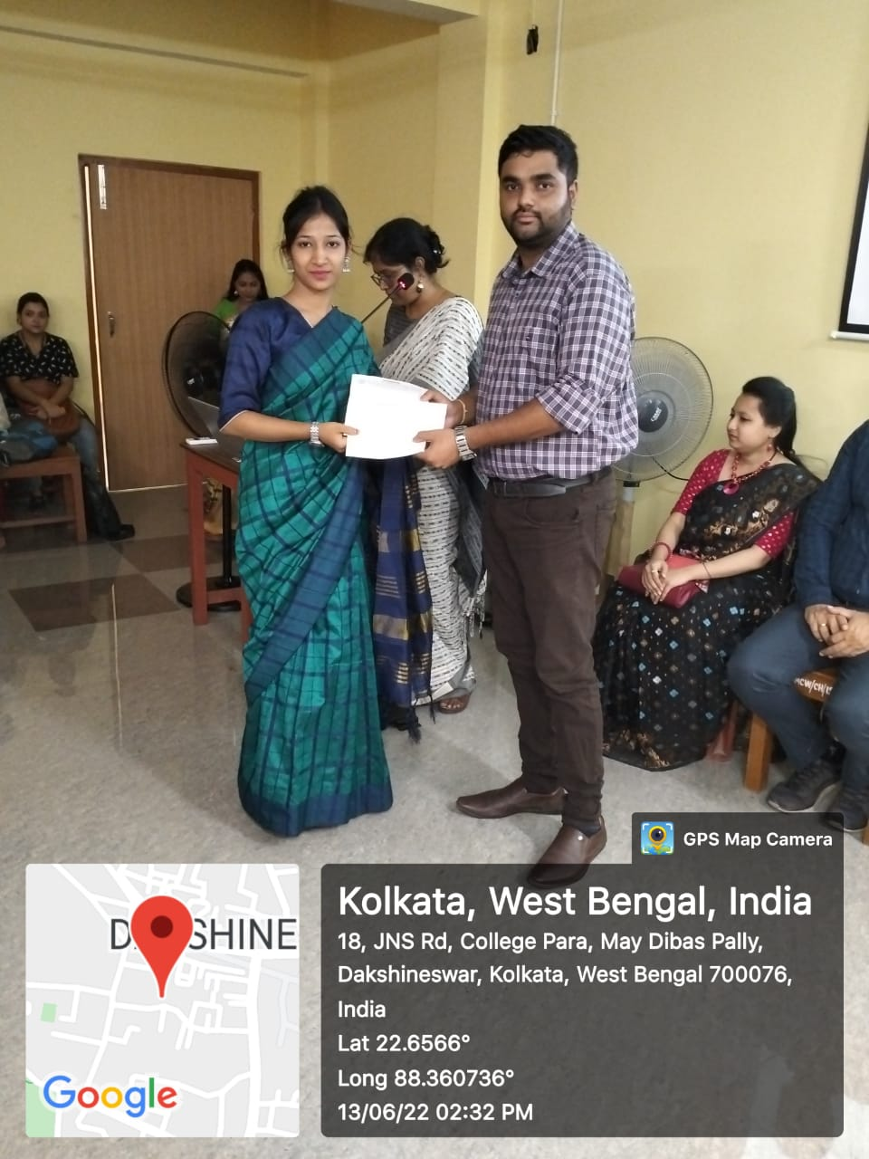
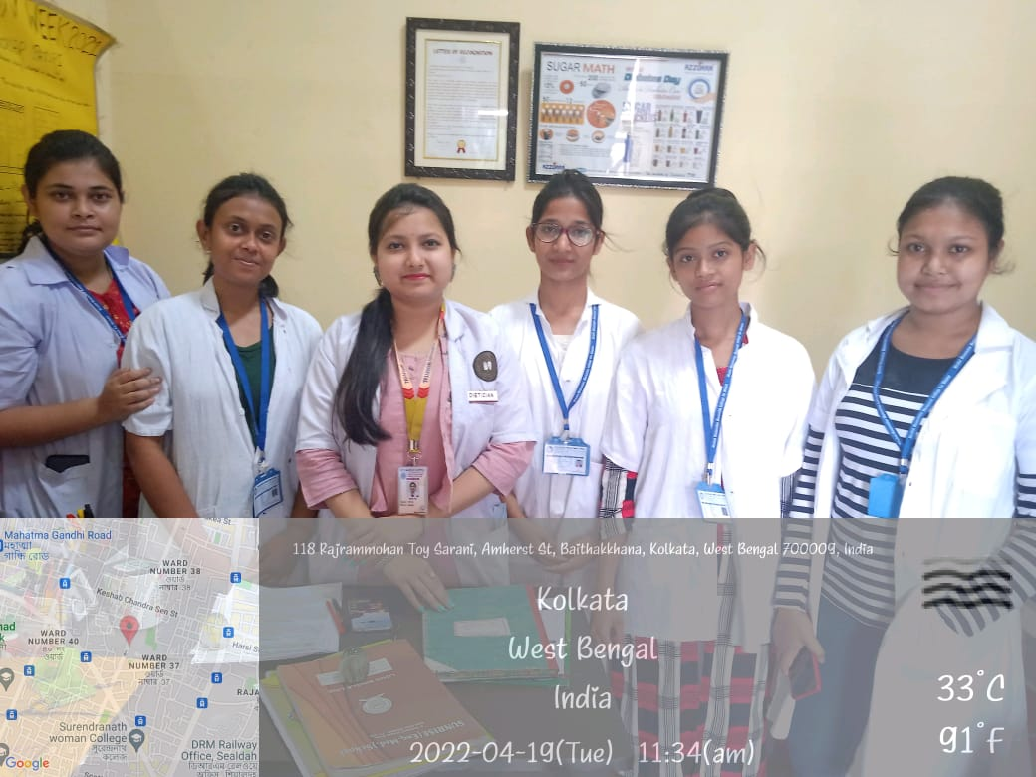
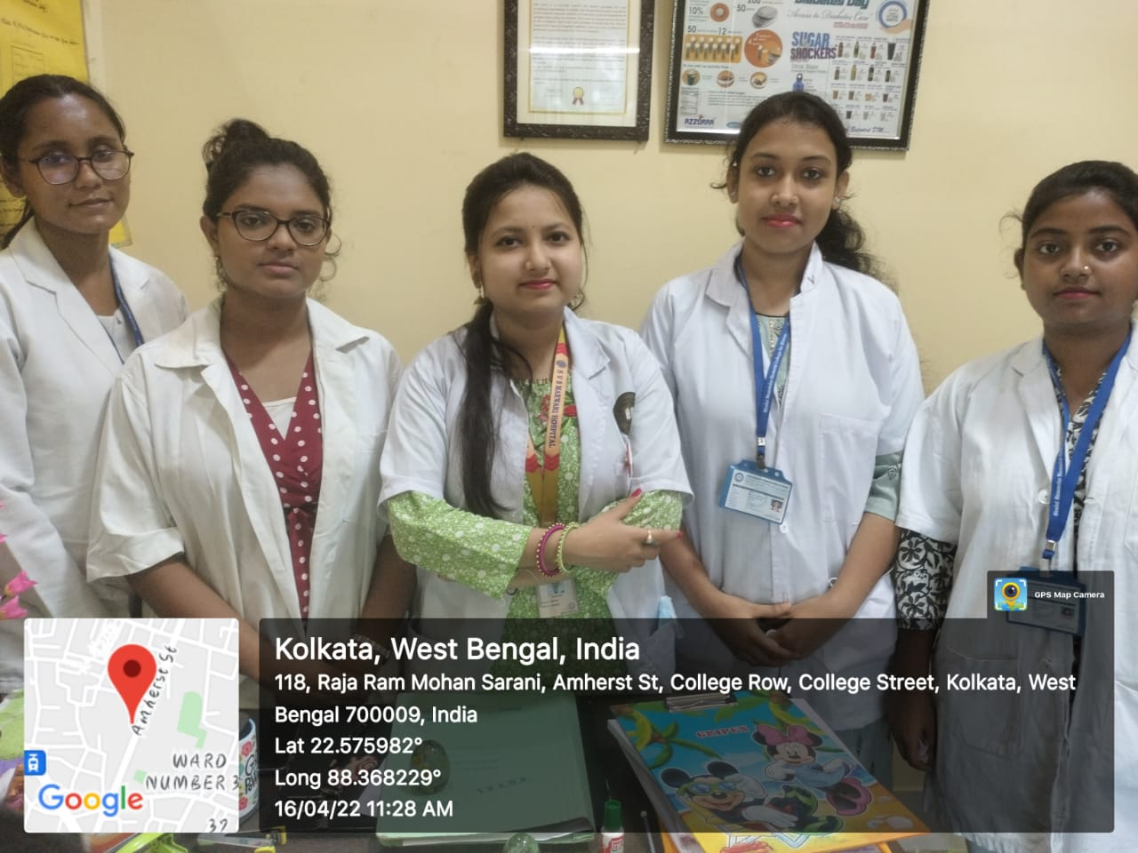
INTERNSHIP AT SVS MARWARI HOSPITAL 2022.

Slide 19
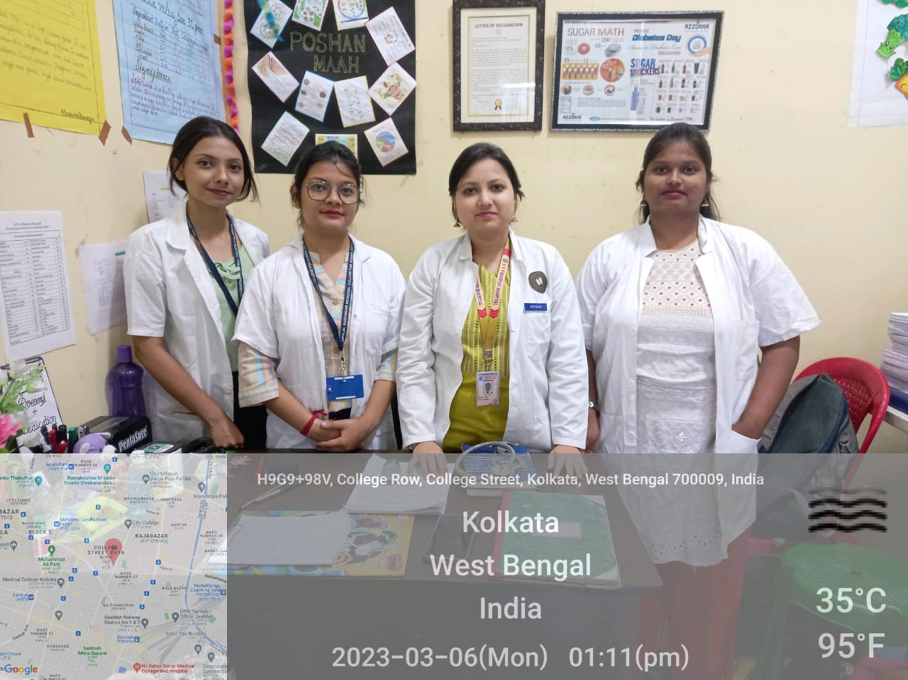
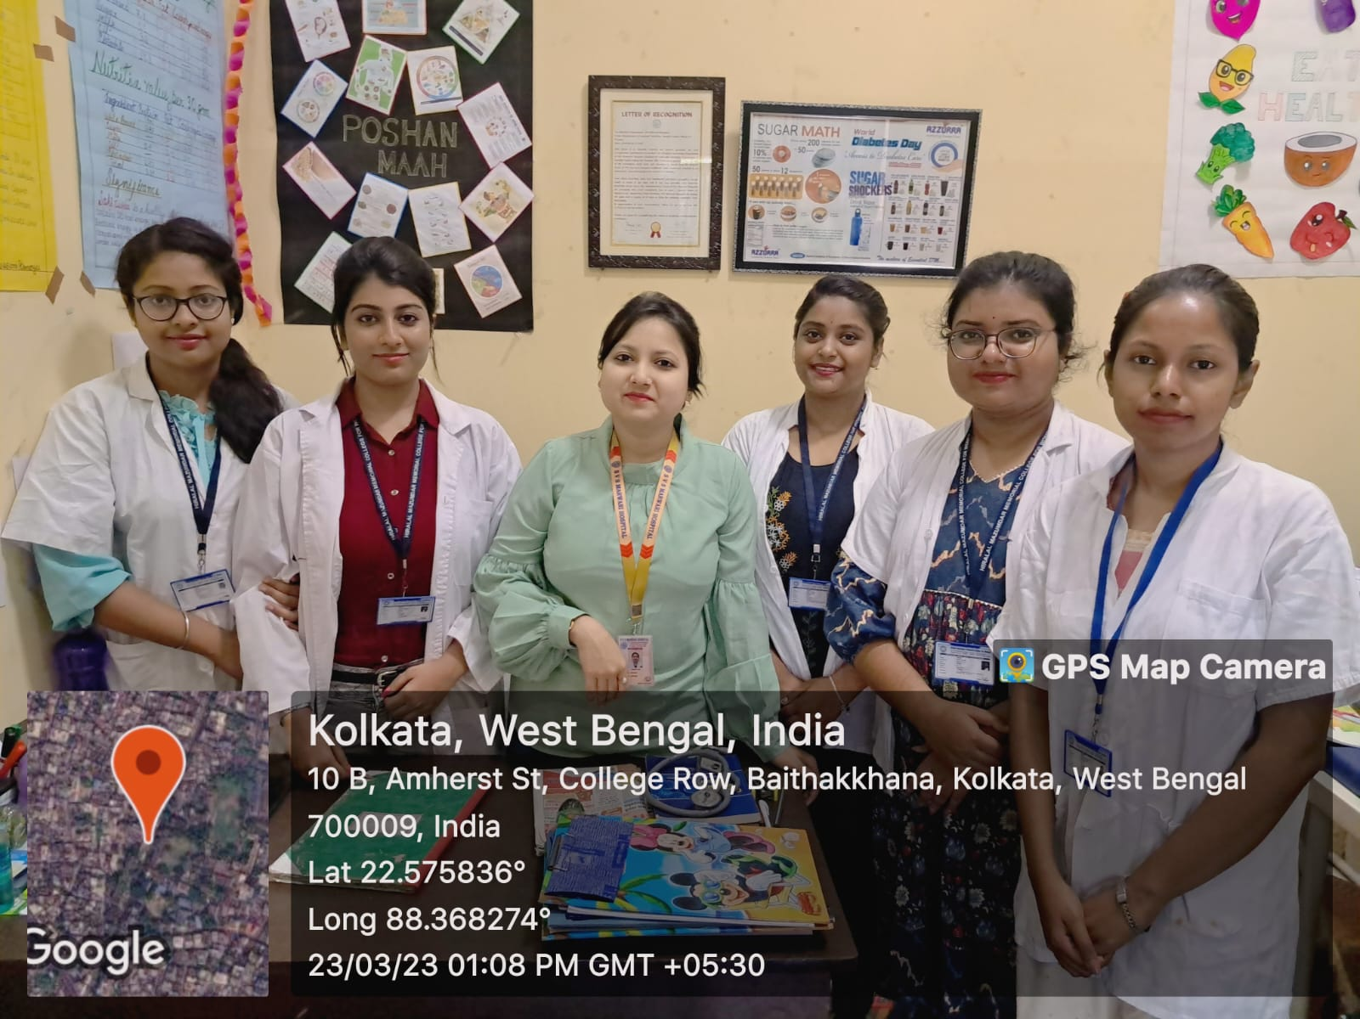
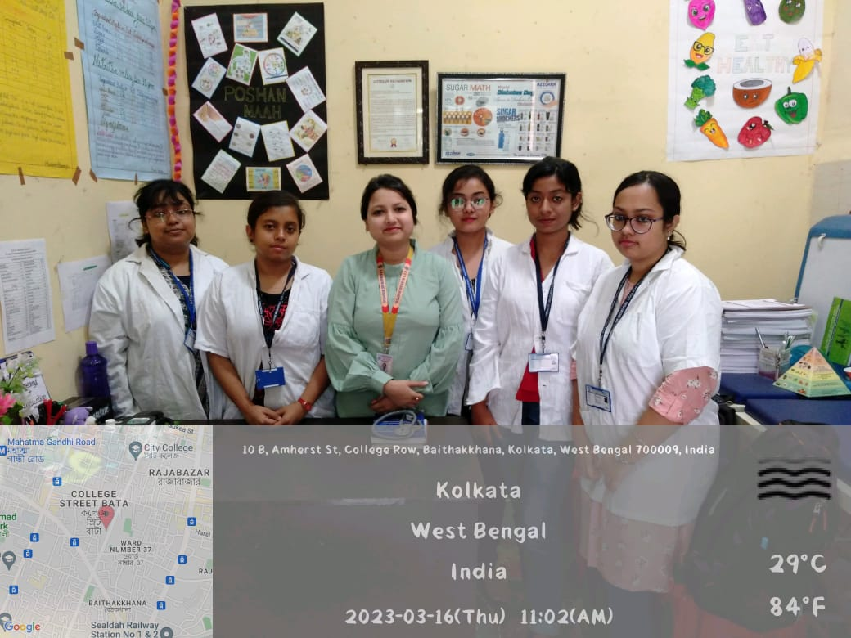
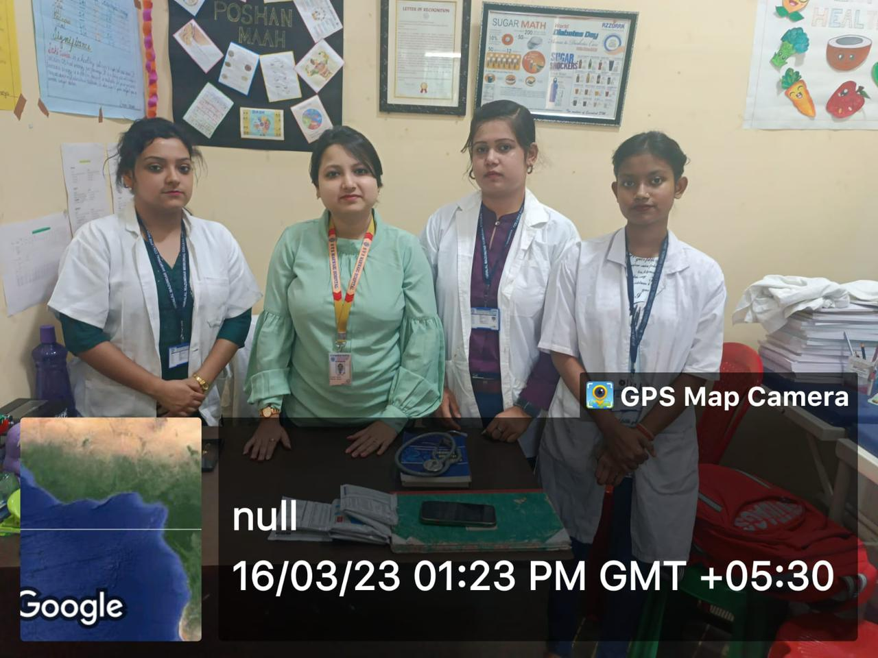
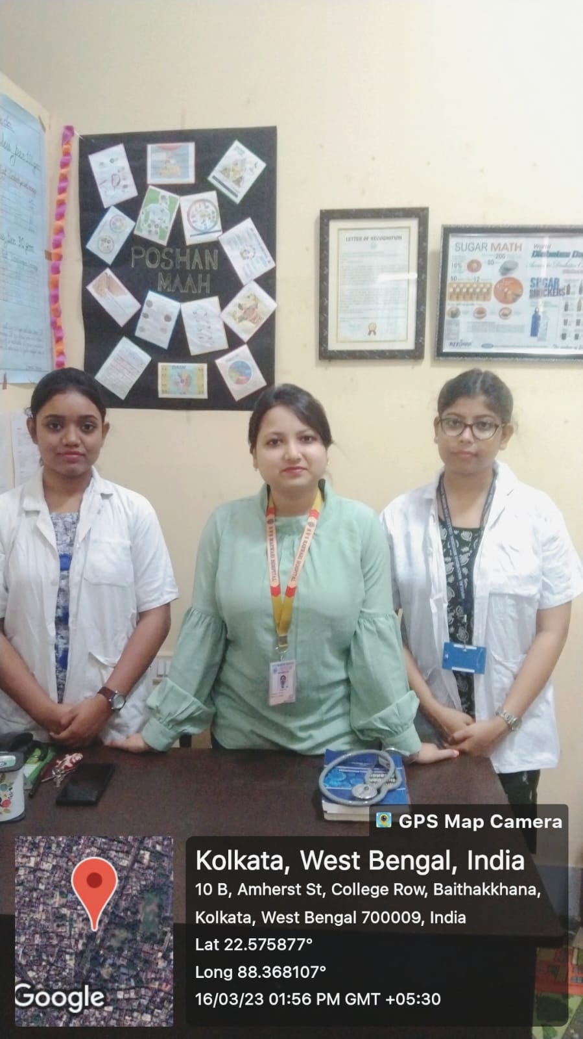
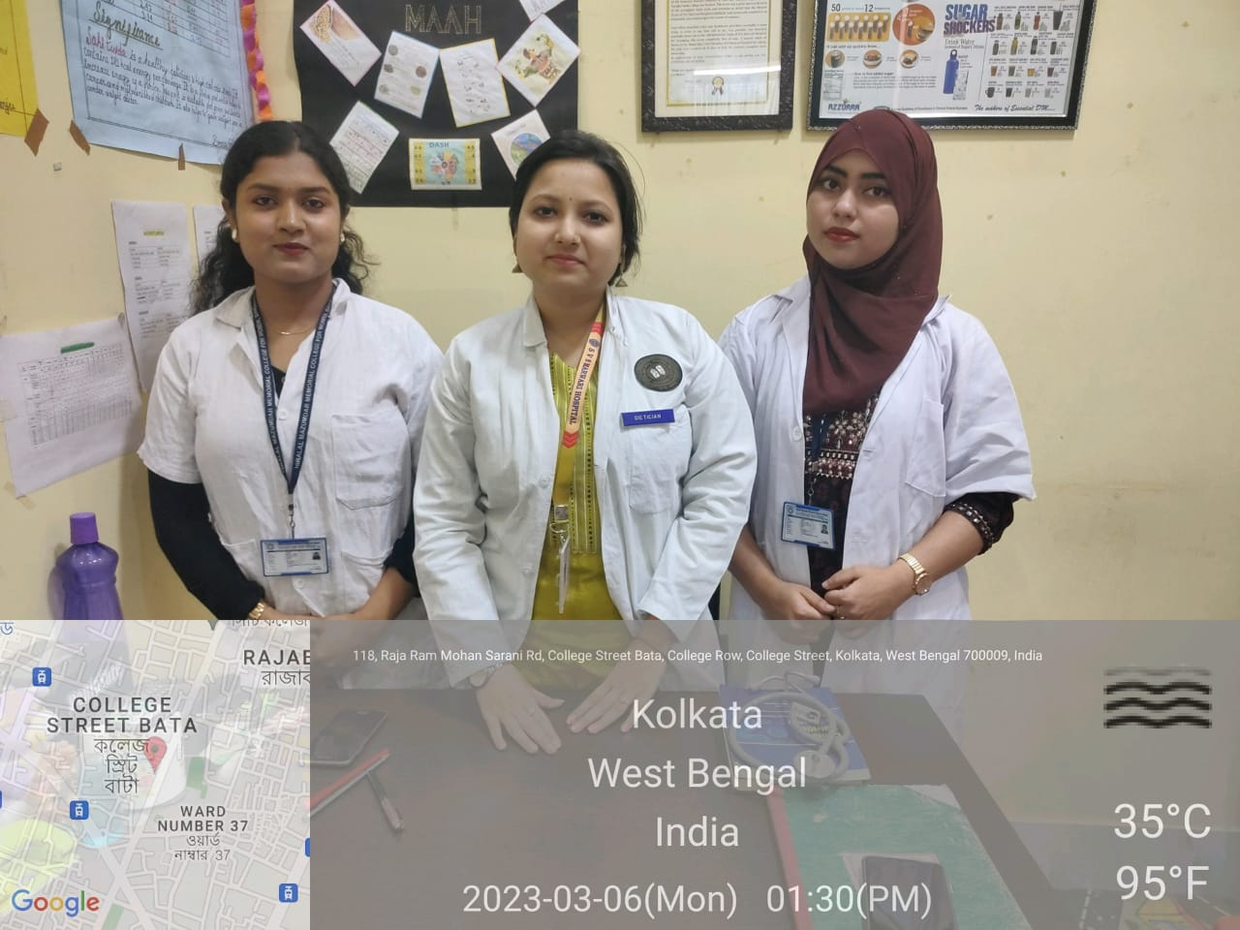
INTERNSHIP AT SVS MARWARI HOSPITAL 2023

Slide 20
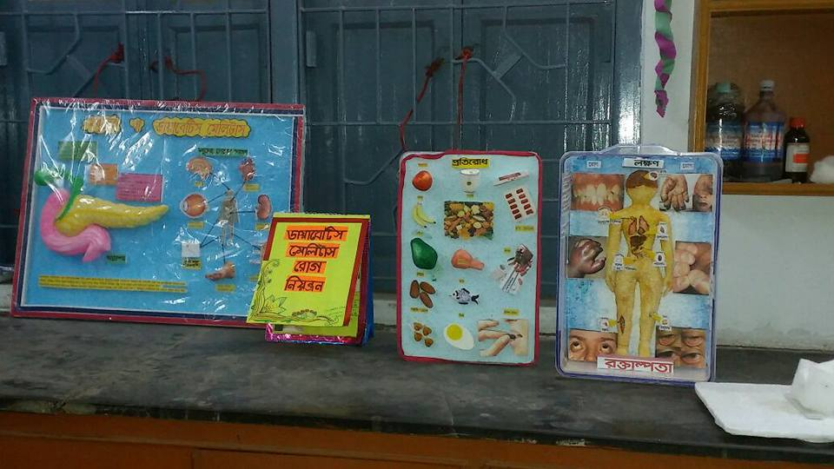
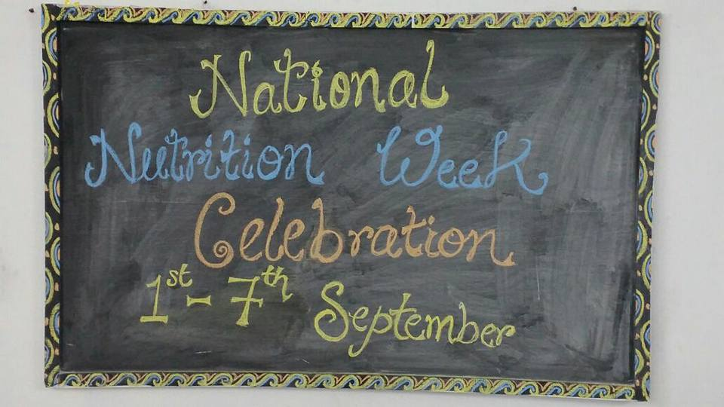
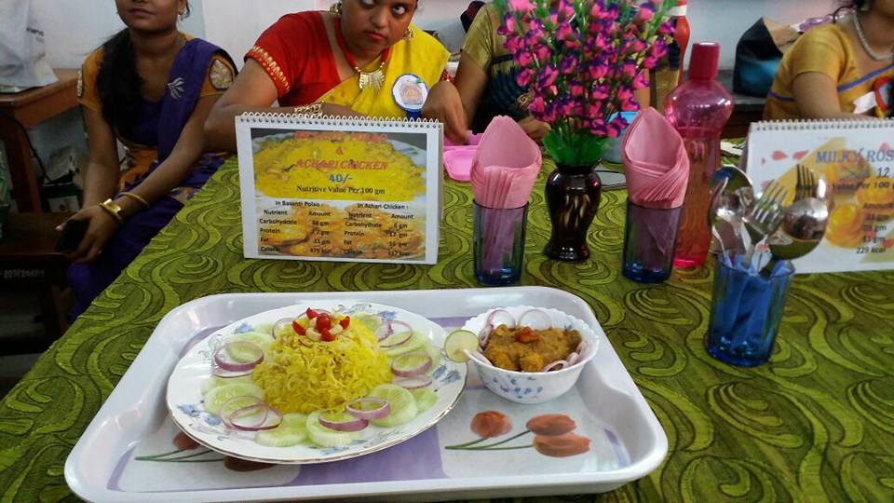
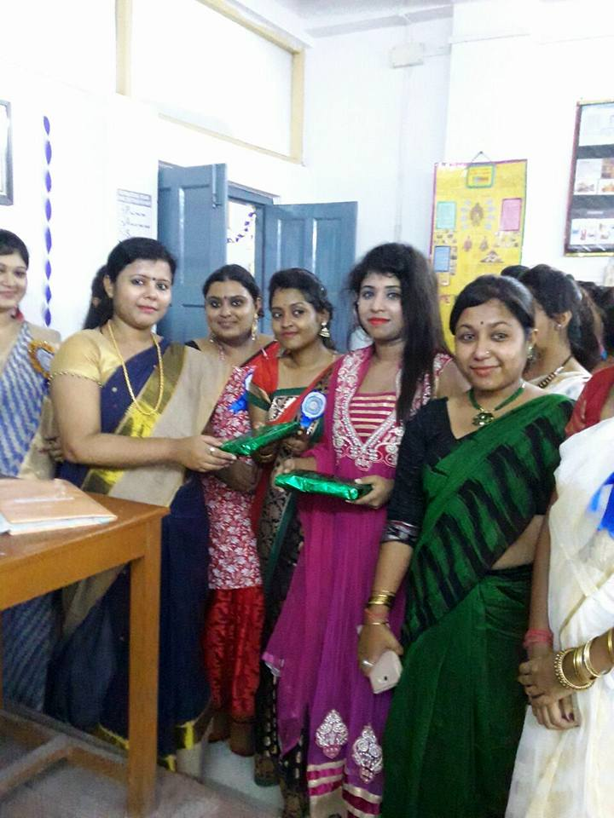
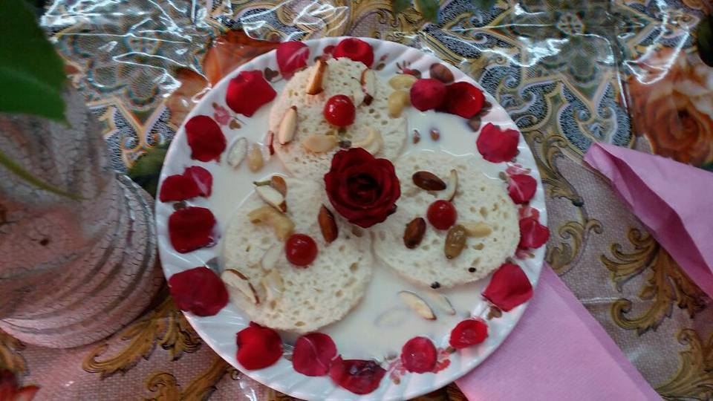
NATIONAL NUTRITION WEEK 2017

Slide 21
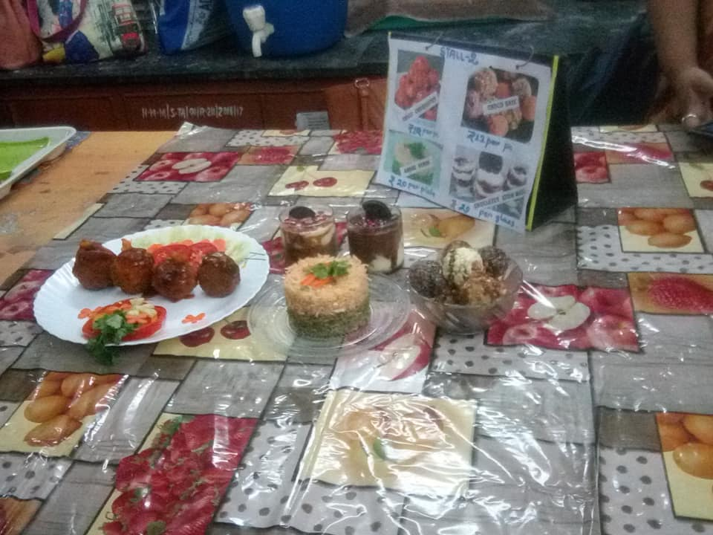
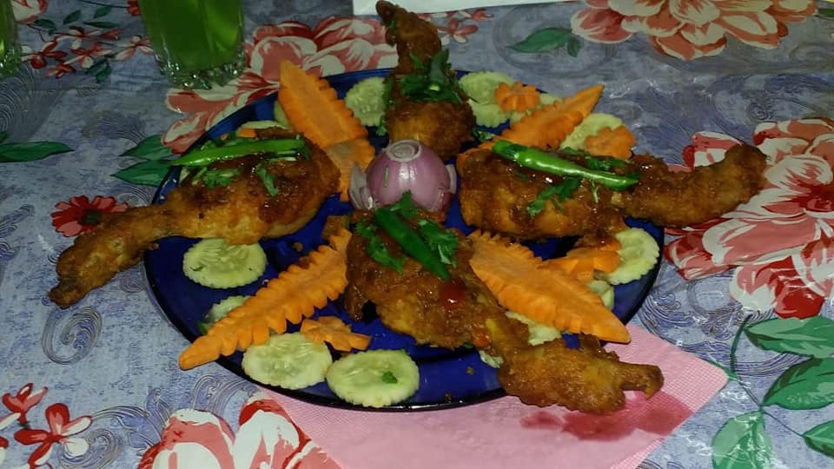
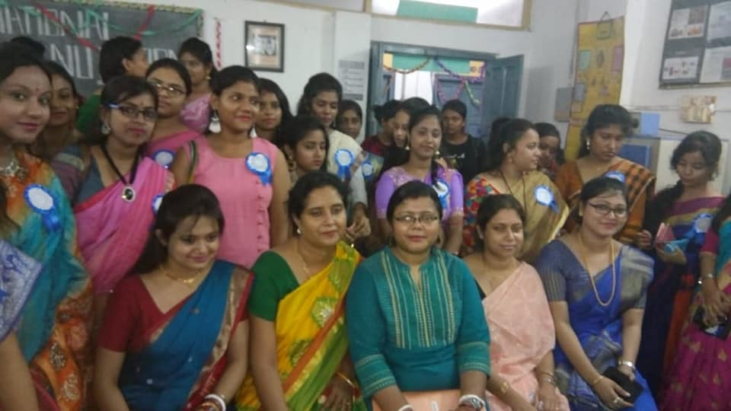
NATIONAL NUTRITION WEEK 2018

Slide 22
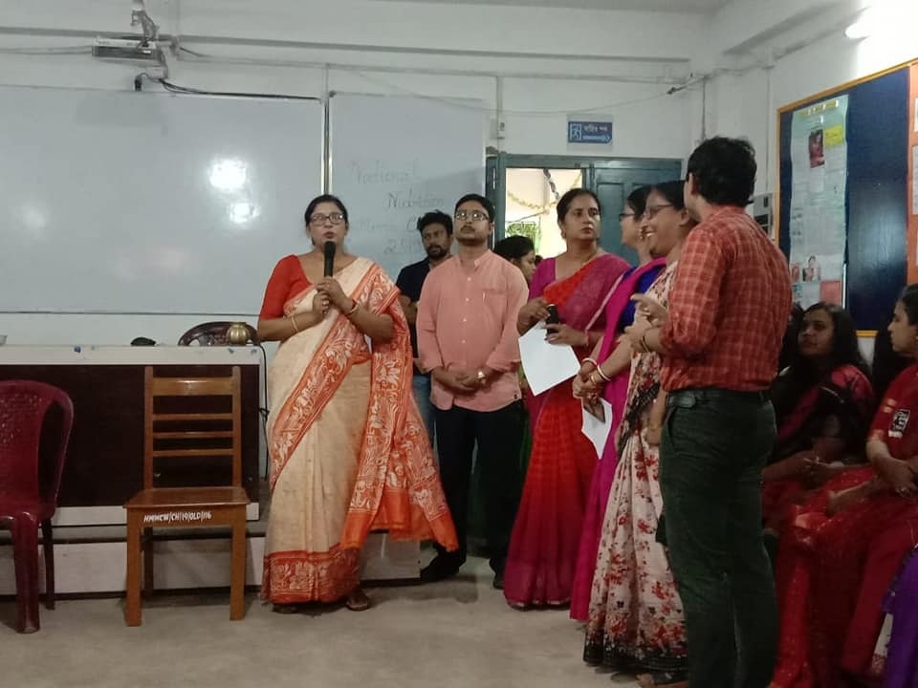
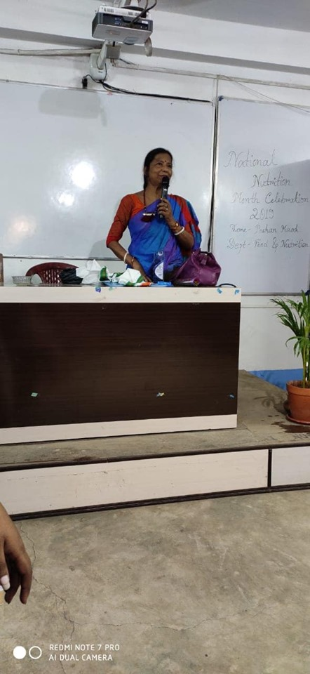
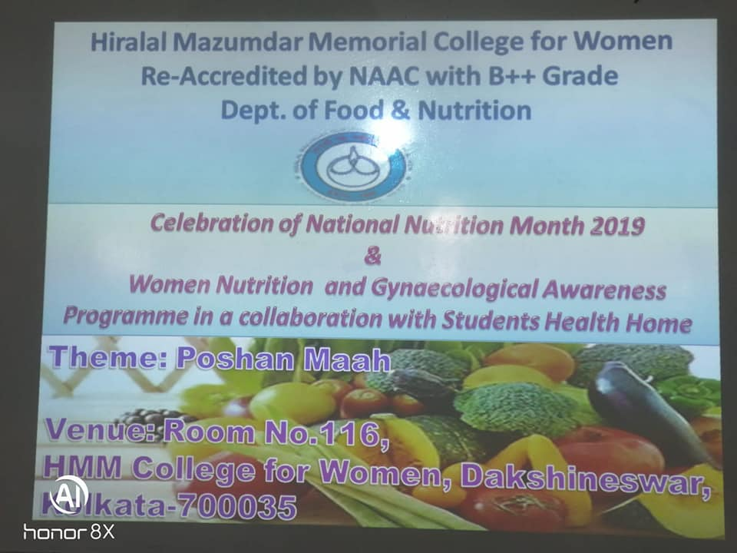
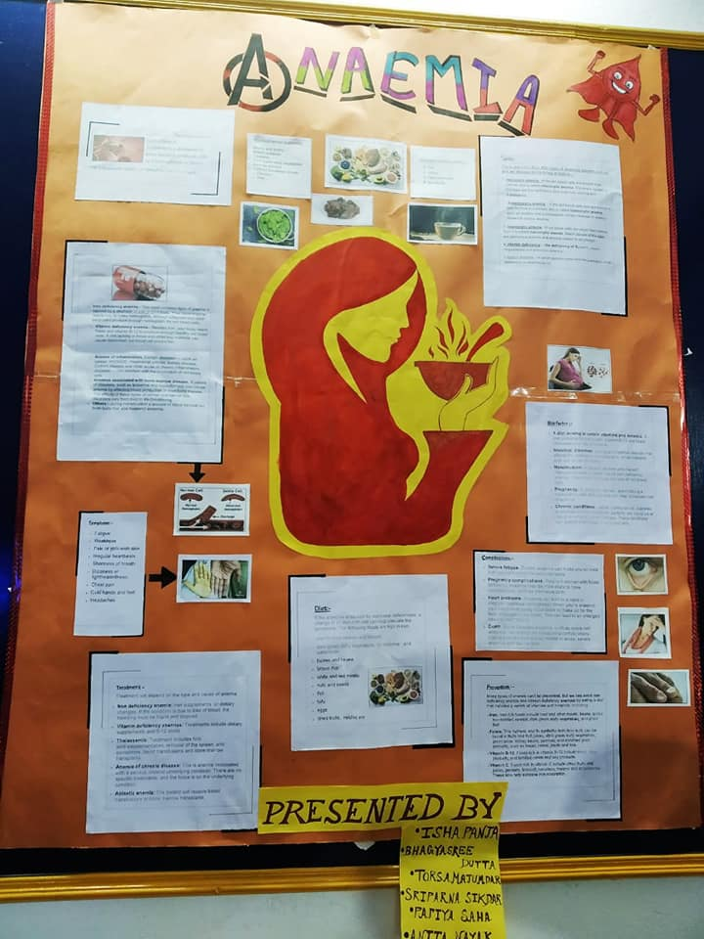
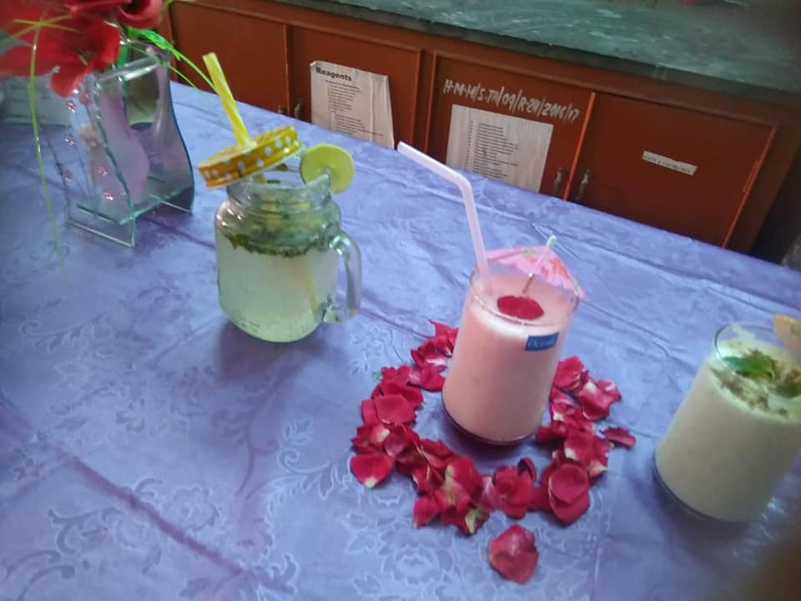
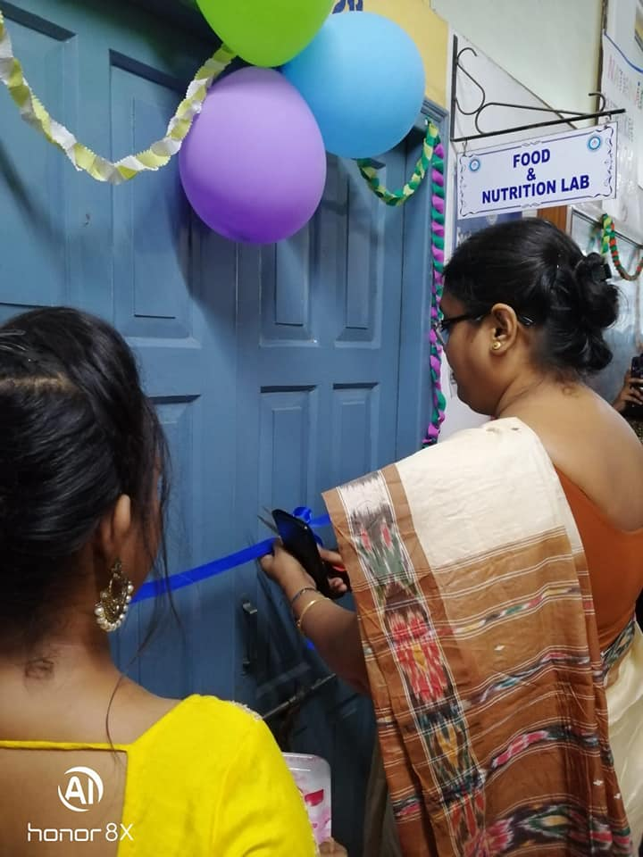
NATIONAL NUTRITION MONTH 2019

Slide 23
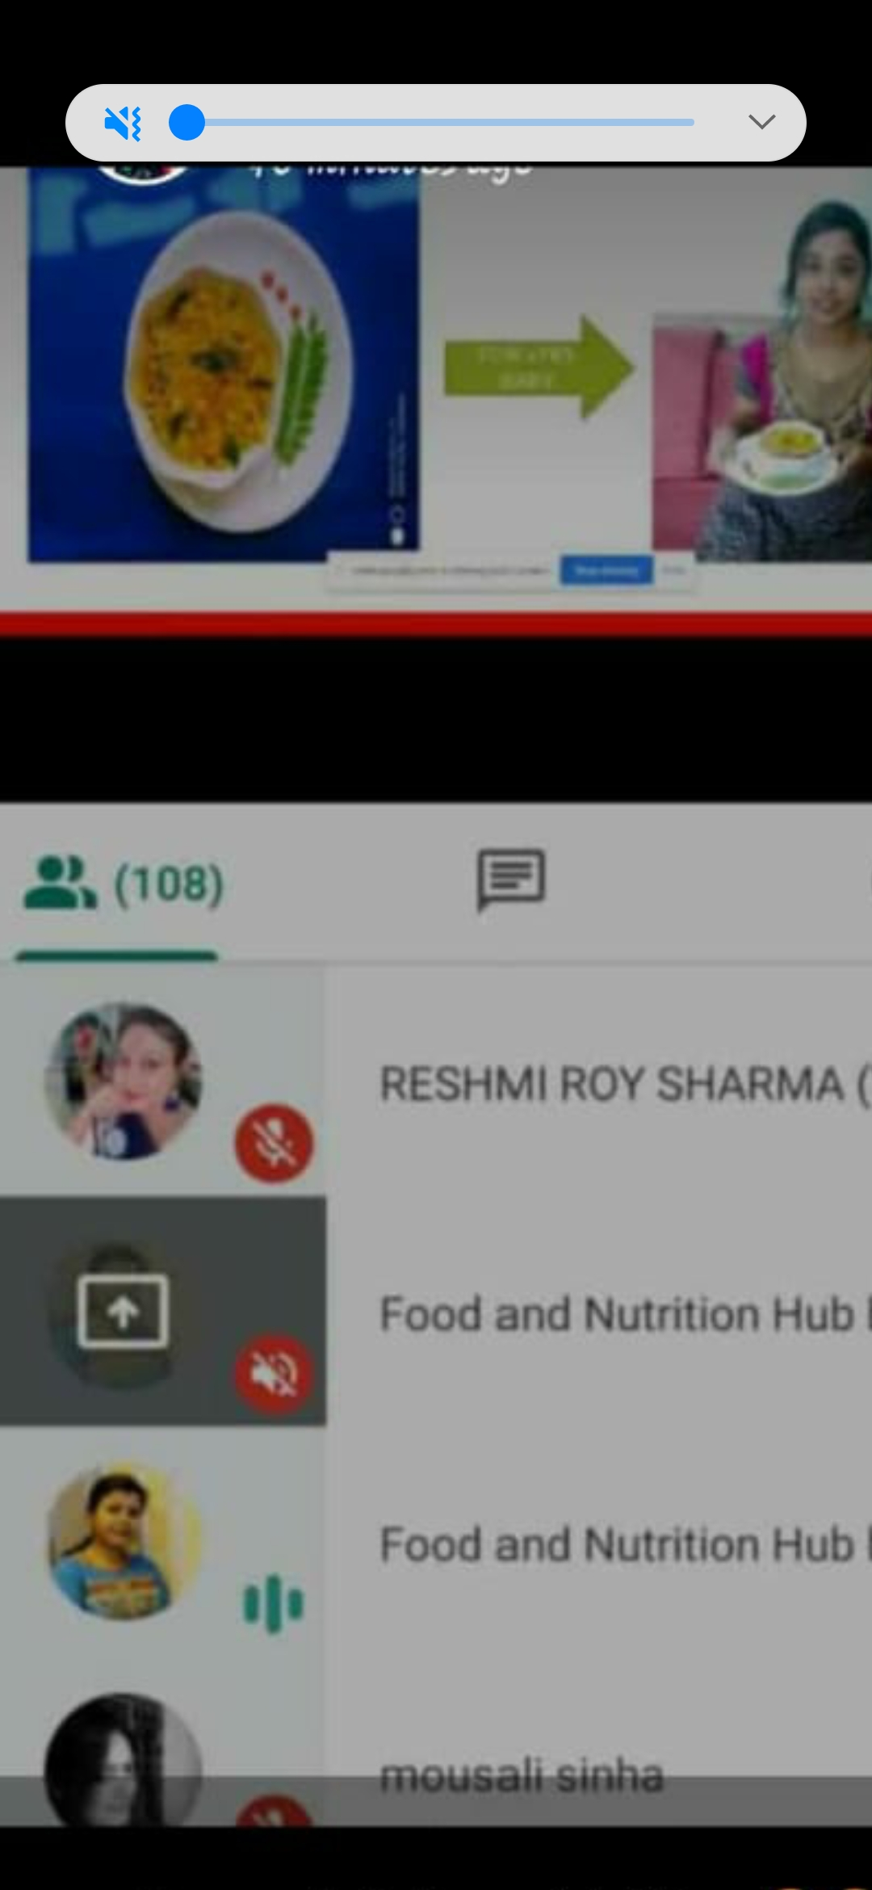
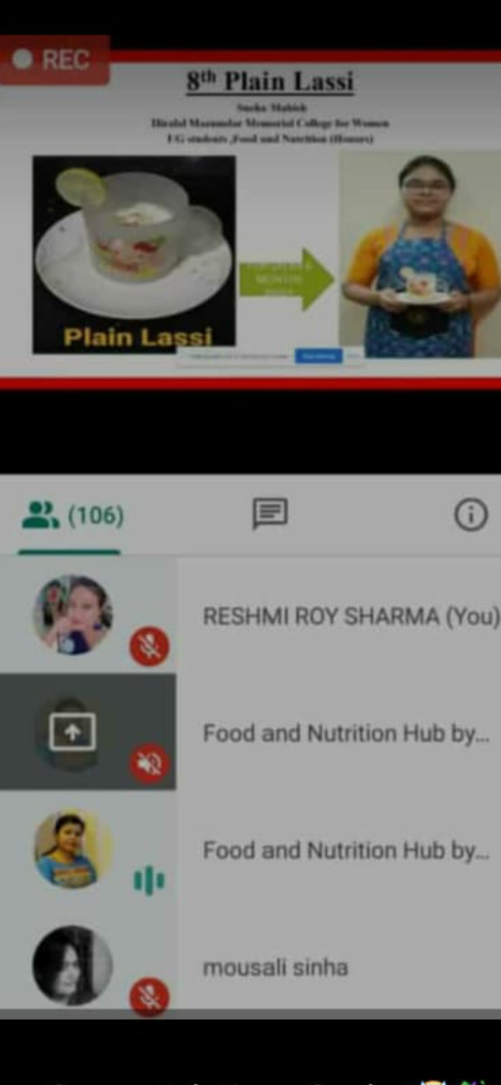
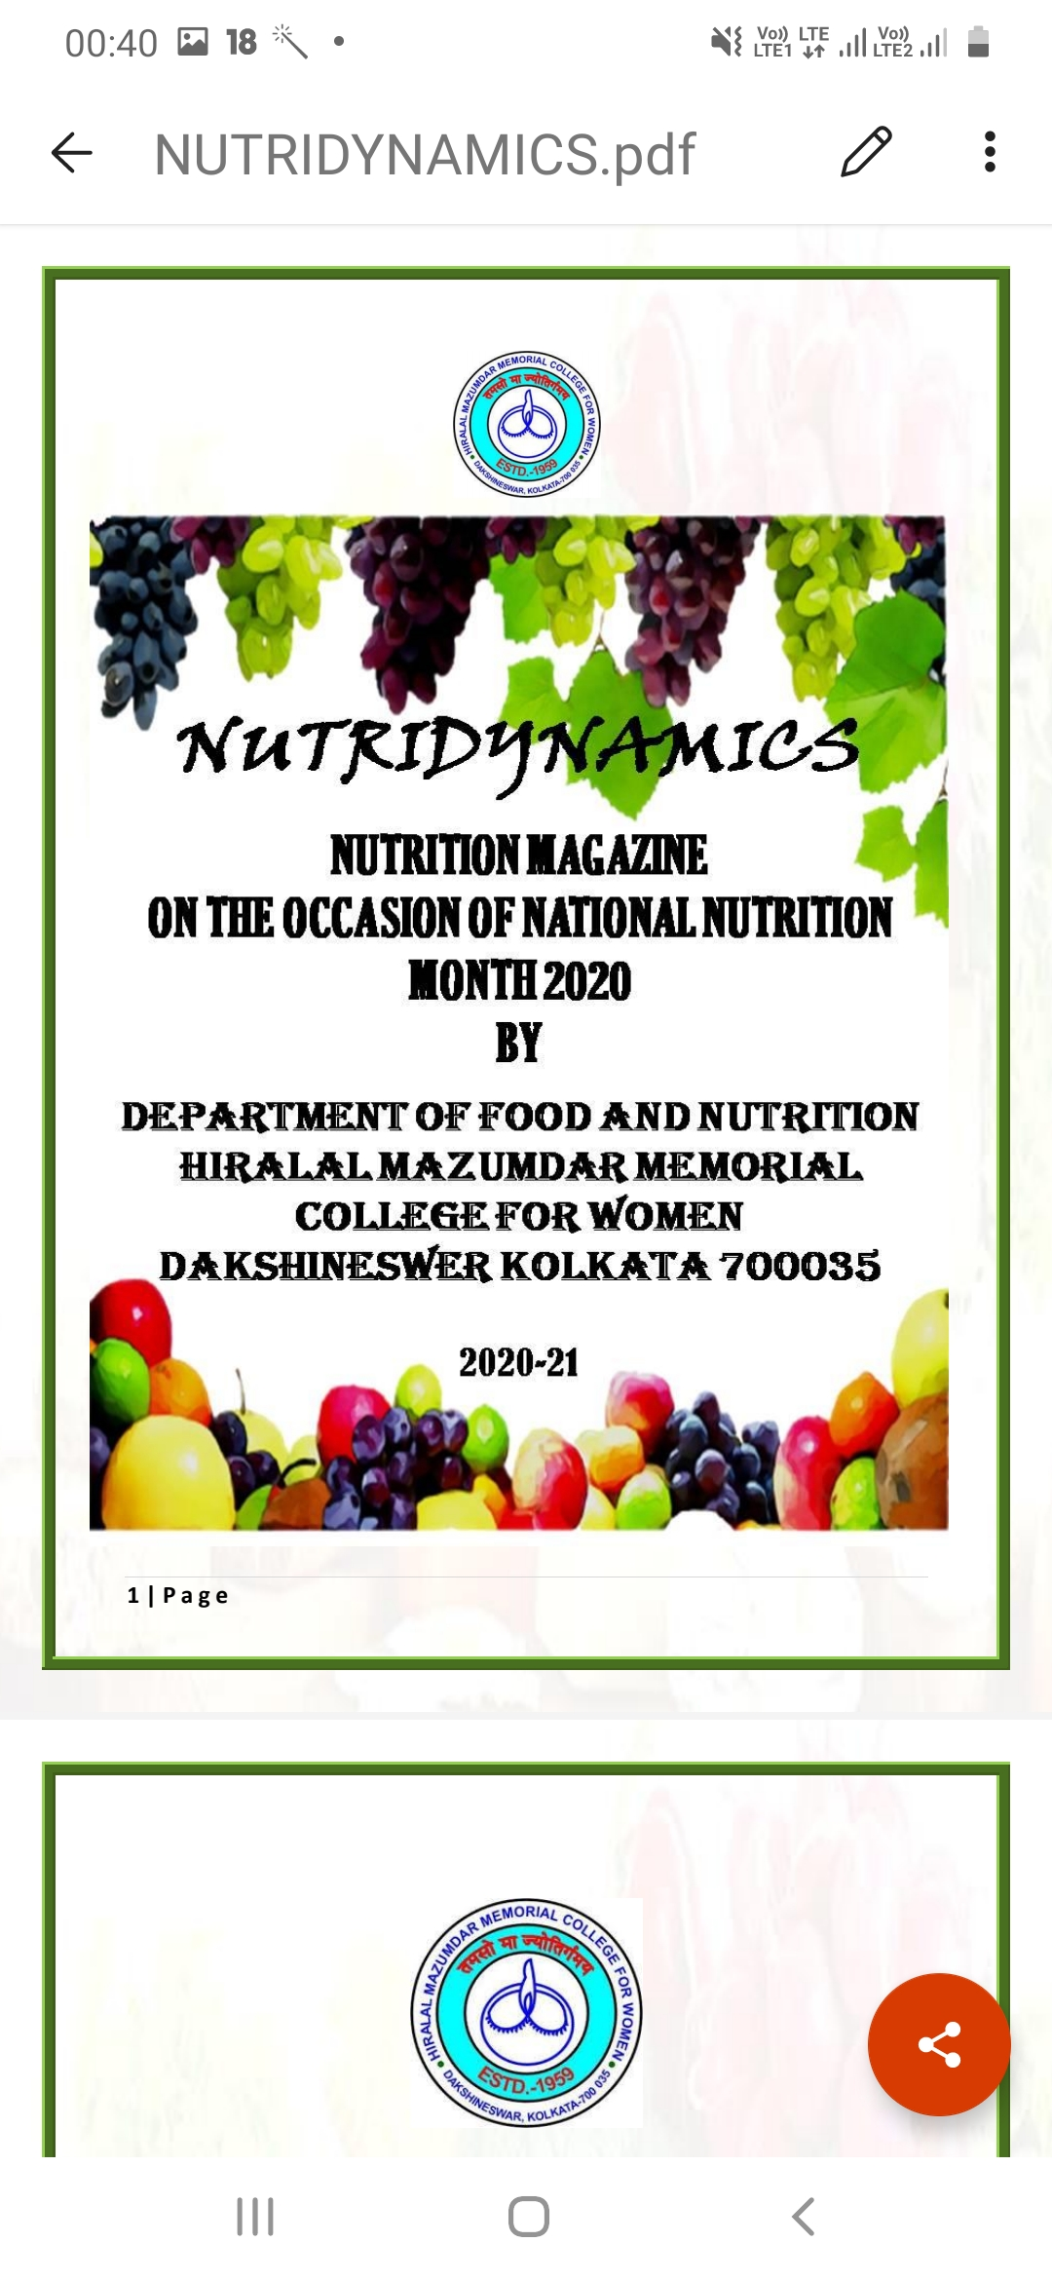
NATIONAL NUTRITION MONTH 2020

Slide 24
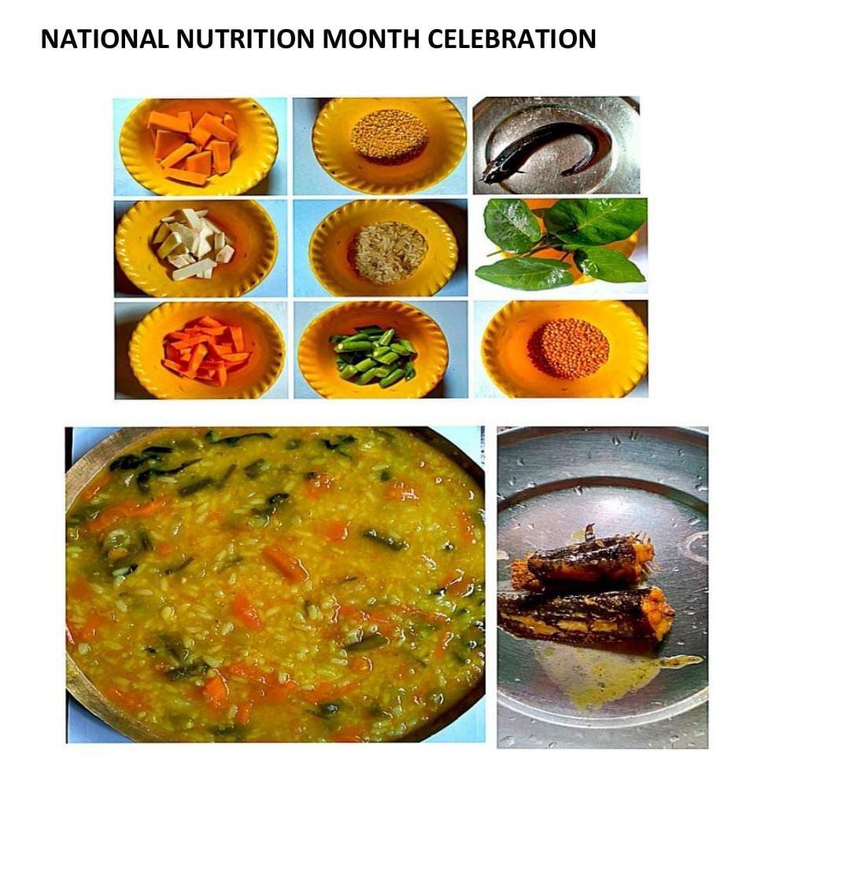
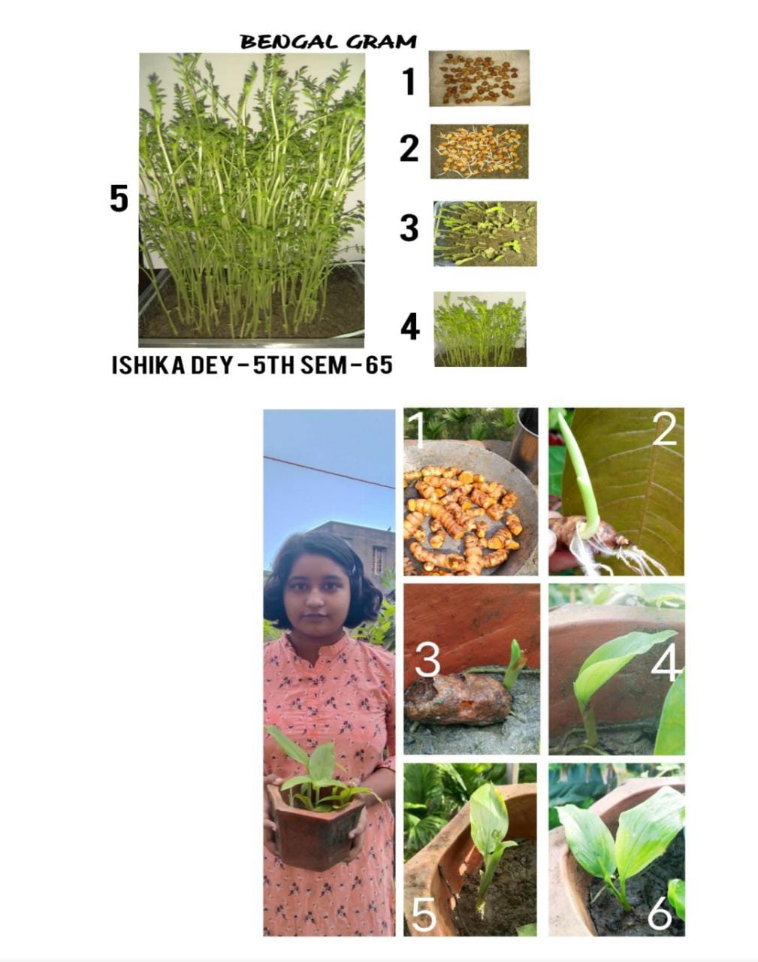
NATIONAL NUTRITION MONTH 2021

Slide 25
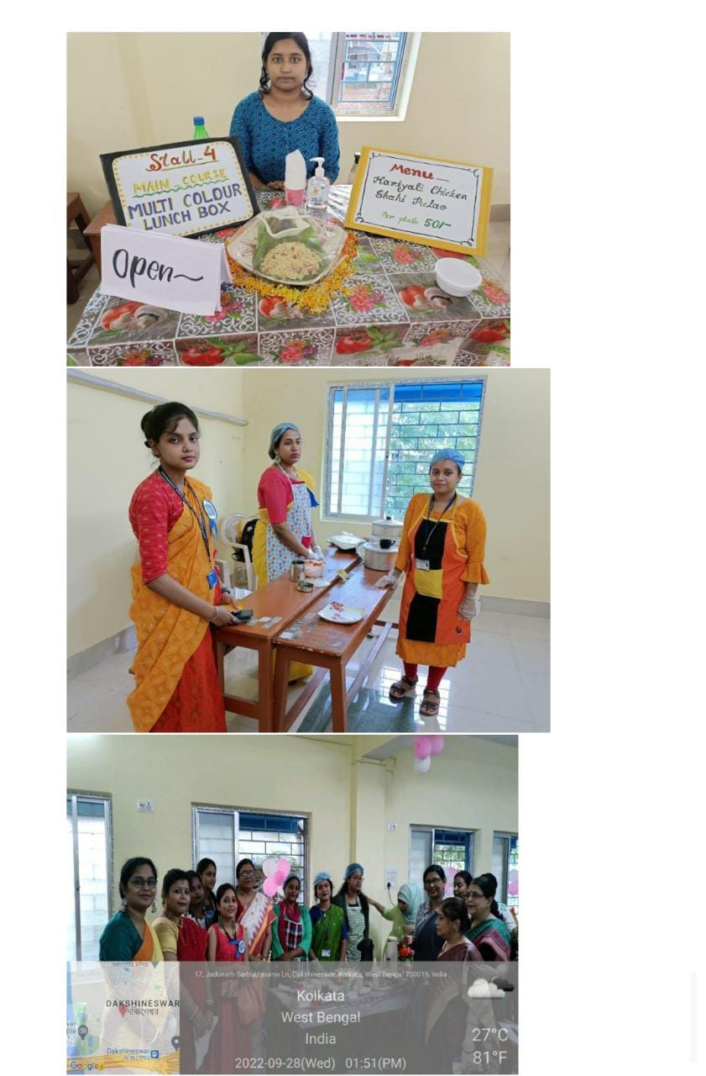





NATIONAL NUTRITION MONTH 2022

Slide 26

PUBLICATION OF E NUTRI MAGAZINE “NUTRIDYNAMICS”

Slide 27



ALUMNI ACTIVITY
Participation in Health Camp during National Nutrition Month 2022
Participation in Science Day Programme 2023
Participation As speaker in Webinar during Pandemic on 1st August 2020

Slide 28




LABORATORY I II III

Slide 29



COOKERY LAB

