Slide 1
SOME NOTED ALUMNI
OF
DEPARTMENT OF FOOD AND NUTRITION
&
ALUMNI ACTIVITY OF LAST 5 YEARS

Slide 2
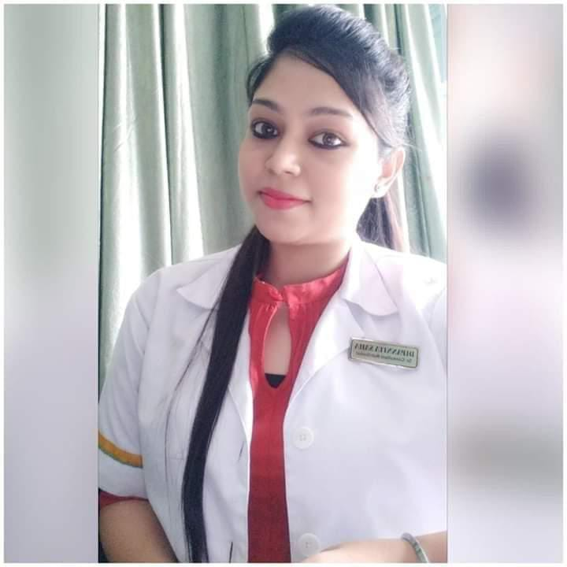
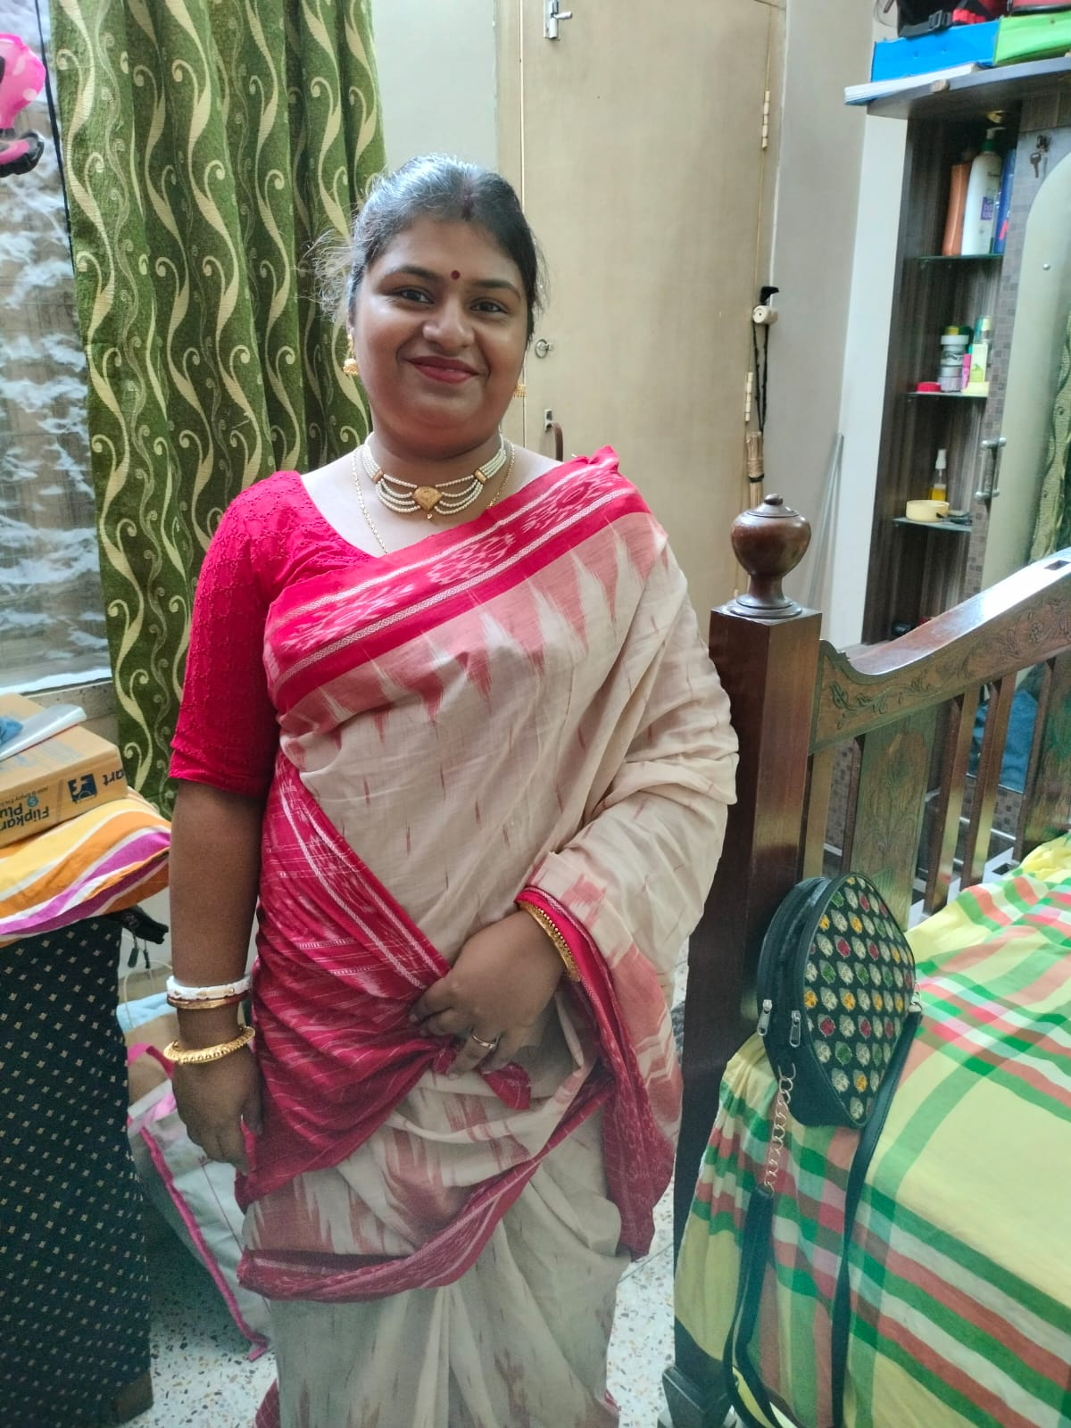
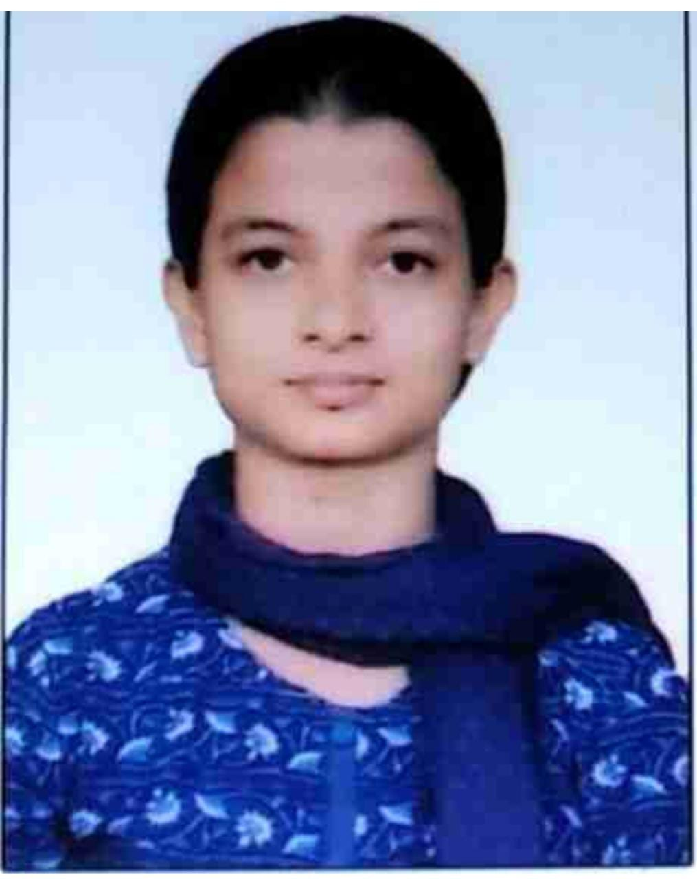
SOME NOTED ALUMNI OF THE DEPARTMENT
SL. No. | Name | Passing Year | PRESENT STATUS | Photo | Documents link
1. | Dt Dipannita Saha | 2009 | Nutritionist/Dietitian (10 yr ex) Owner of HEALTH CONSCIOUS WELLNESS & DIET CLINIC |  | https://drive.google.com/file/d/19fsuUrhUO5z9sXXpMJQgpr8LLhhEbrY5/view?usp=sharing
3. | Meholi Ghosh | 2010 | Cracked WBSSC ,Assistant Teacher , Goalpara High School (H.S) FROM 12.12.2019 |  | https://drive.google.com/file/d/1ISzDxXXyddXHpwJLS15FggiQom-CprRF/view?usp=sharing
4. | Ananya Pariwal | 2011 | Assistant Manager STATE BANK OF INDIA, HOWRAH BRANCH |  | https://drive.google.com/file/d/1ArrSqrBP8zhgoiRyrxCSLmM9AP-nD7DG/view?usp=sharing

Slide 3
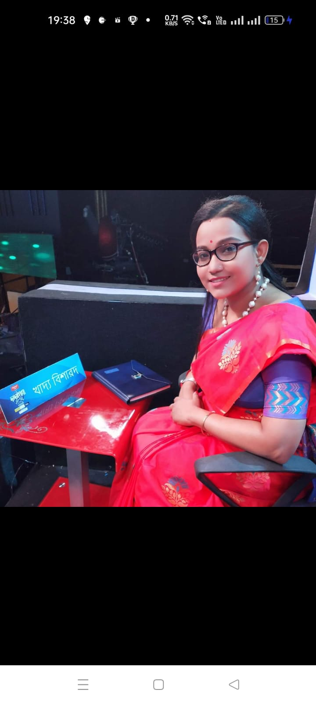
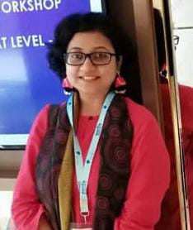
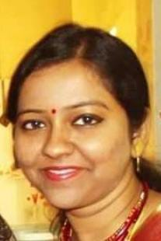
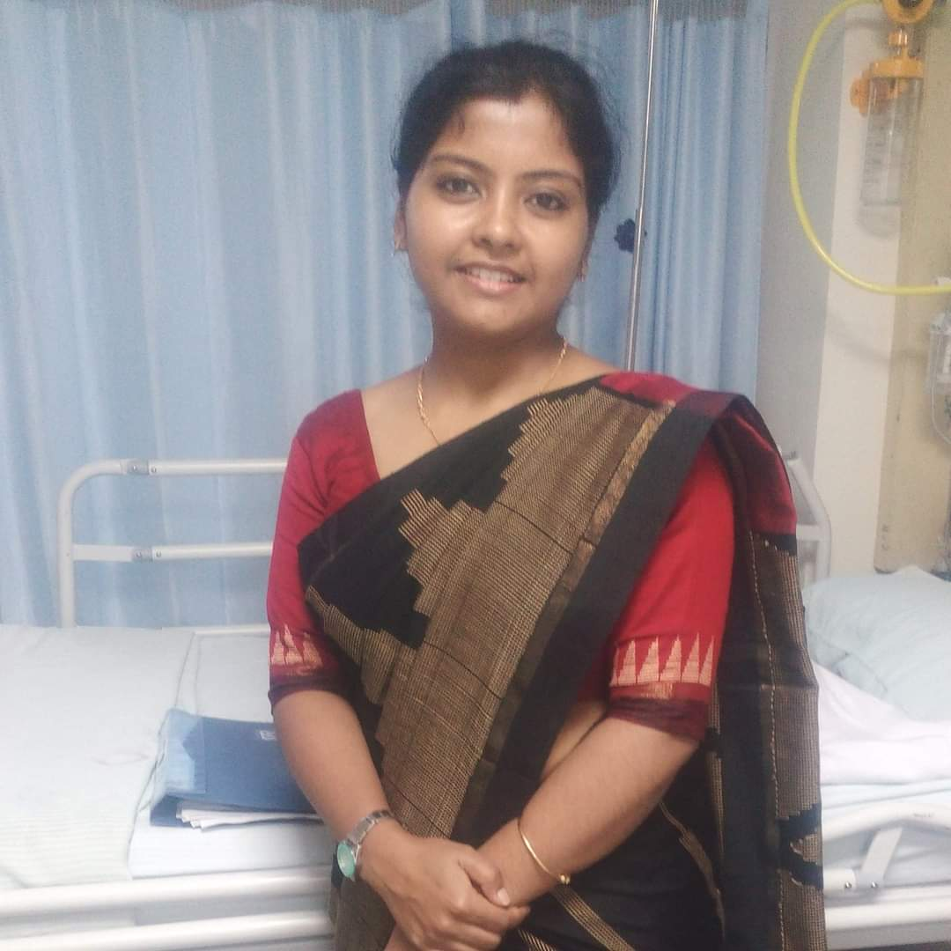
SOME NOTED ALUMNI OF THE DEPARTMENT
SL. No. | Name | Passing Year | PRESENT STATUS | Photo | Documents link
5. | Sharmishta Roy (Dutta) | 2011 | Consultant Dietitian , Owner of Diet clinc “NUTRITION MANTRA”Certified Diabetic Educator, Laughter therapy Trainer, |  | https://drive.google.com/file/d/1CX0vZ_THu5XDR3t8Npz8qjl7fQ0iH3Do/view?usp=sharing
6. | Debanjali Jairam | 2011 | Pursuning masters in Hospital Administration from MANIPAL ACADEMYFormer Dietician at Fernandez Hospitals Hyderabad |  | https://drive.google.com/file/d/1IQdCxhQKlSRadCBhFv6mtHlWnq4XXKNq/view?usp=sharing
7. | Binandita Biswas | 2009 | ASSISTANT GRADE-III(Tech)in FCI INDIA |  | https://drive.google.com/file/d/1uqRASIxp_Wuefe1gTPHHxwSLNrEw5n5e/view?usp=sharing
8. | Vagyasree Roy | 2011 | Dietitian and Owner of Vagyasree Diet Clinic |  | https://drive.google.com/file/d/1mW89EPSZDZSl31tLE8Nz7dR3AASsJd5H/view?usp=sharing

Slide 4
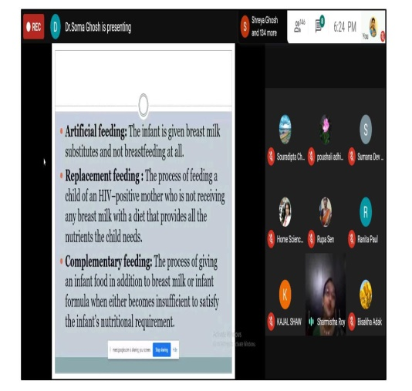
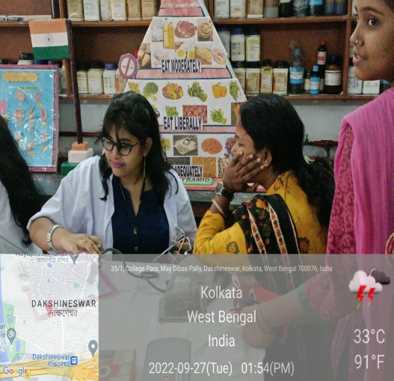
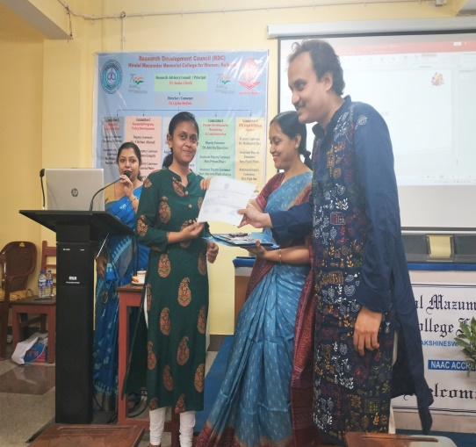
ALUMNI ACTIVITY
Participation in Health Camp during National Nutrition Month 2022
Participation in Science Day Programme 2023
Participation As speaker in Webinar during Pandemic on 1st August 2020

