Slide 1
STUDENTS ACHIEVEMENTS
OF
DEPARTMENT OF FOOD AND NUTITION

Slide 2
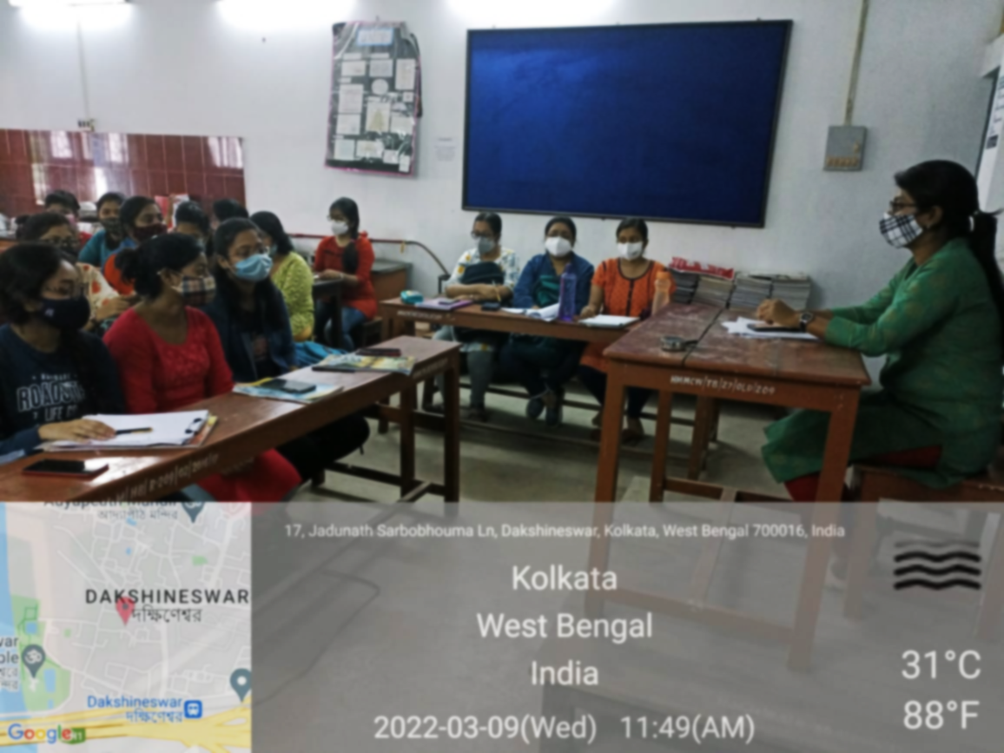
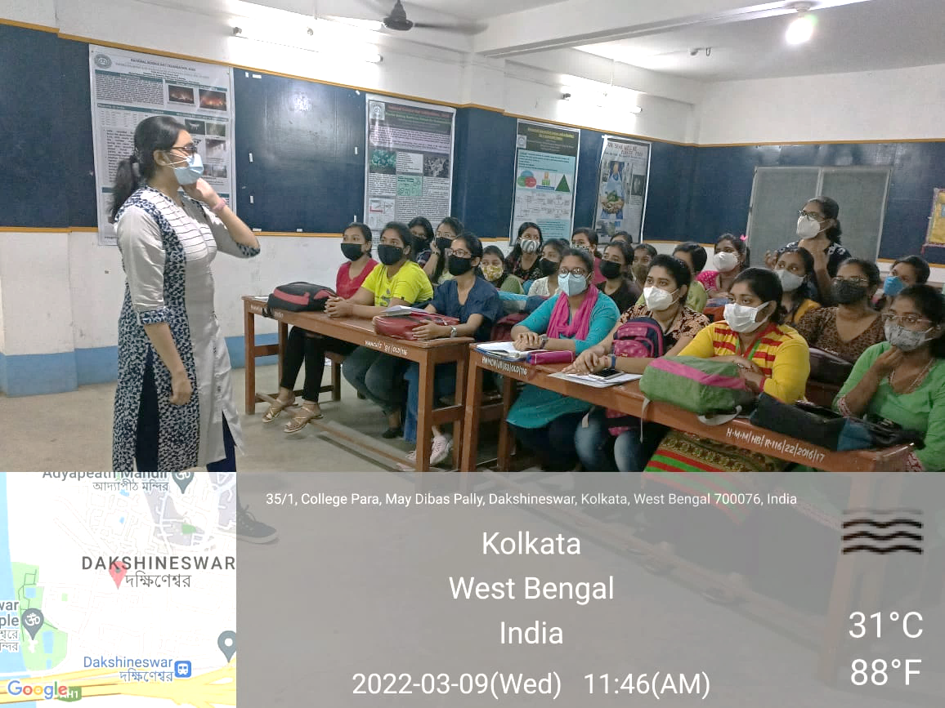
Alumni Students Achievements in National Examination
Name of the Students | Achievement
Priyanka Ghosh | UGC NET –JRF (Roll No-91028847)2018 Joined Rajabazar Science College Calcutta University , as a Research Fellow From CU https://drive.google.com/file/d/1Oh528WnXhVG18btJ0scDYXN1xQrIFmHz/view?usp=drive_link
Suparna Paul | UGC NET –LS 2020 (WB1051800577) Worked as a facilitator in Department of Food and Nutrition.(2021-2022) https://drive.google.com/file/d/12agoYL9CpEjuGMItwKIth-9hfqFX-dap/view?usp=sharing
Souradipta Chakraborty | UGC NET –JRF (Roll No-WB0651800007) 2020 Joined Calcutta University , as Research Fellow from February 21 https://drive.google.com/file/d/1pGucSlbrRfAcQJ0goo-xk-5lNNdH4nJ7/view?usp=drive_link
Swetanjana Ghosh | NET – JRF Worked as a facilitator in Department of Food and Nutrition.(2021-2022) Joined Jadavpur University, as Research Fellow from April 22 https://drive.google.com/file/d/1tab3mFOA9kYCBL5aOVdfMWPQS9Dg5aMW/view?usp=sharing

Slide 3
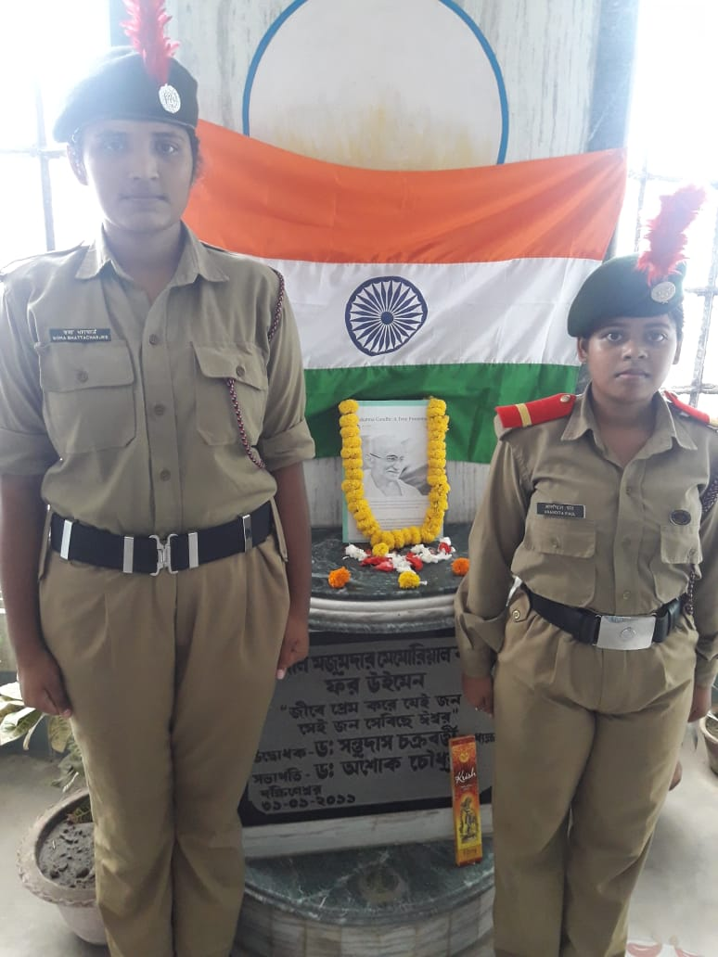
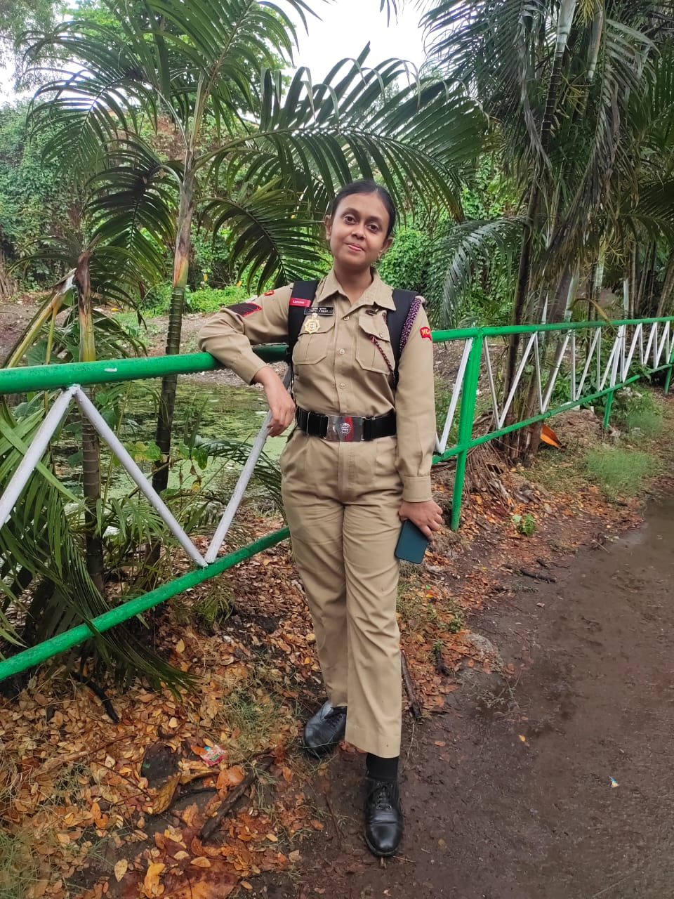
Students Achievements In NCC
NAME OF THE STUDENTS | ACHIEVEMENT
Anandita Paul | Senior Under Officer 20 Bengal NCC unit 2019
Soma Bhattacharjee | Junior Under Officer, 20 Bengal NCC unit 2019
Tripti Kumar | Rank promotion till -CQMS(COMPANY QUARTER MASTER SERGEANT) Was selected for a National Camp at Sikkim, Namchi, and secured 2nd position under Health and Hygiene( written exam +viva) Secured 2nd position in college and came under top 3 in my whole NCC UNIT(20 Battaliom Ncc Unit)..in C-certificate exam i.e., 3rd year NCC exam https://drive.google.com/file/d/1Ivw9-UHLWuqhOkZNcWEIThXgQ5CPtSsA/view?usp=sharing

Slide 4
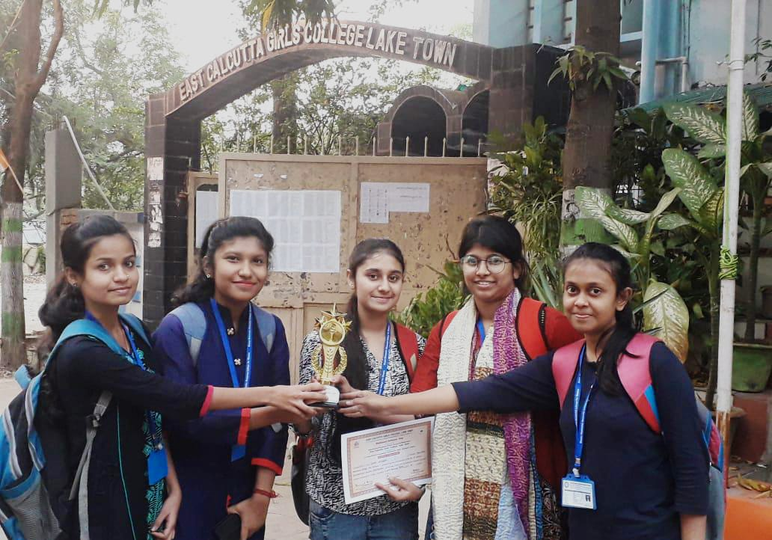
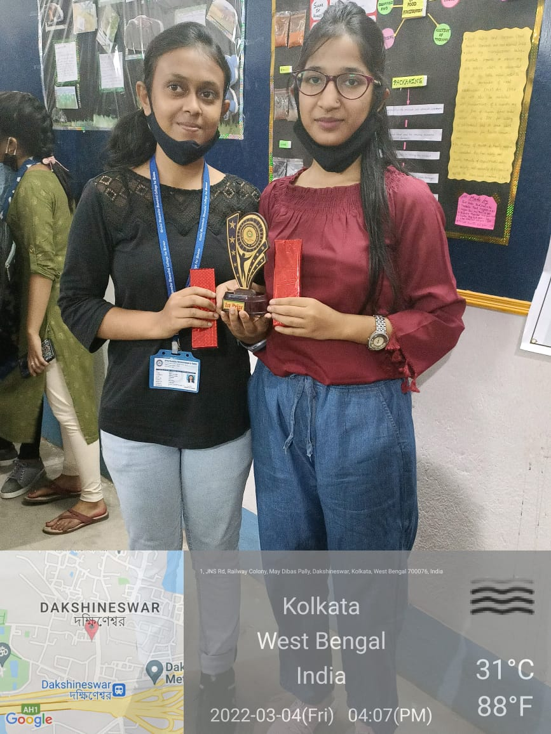
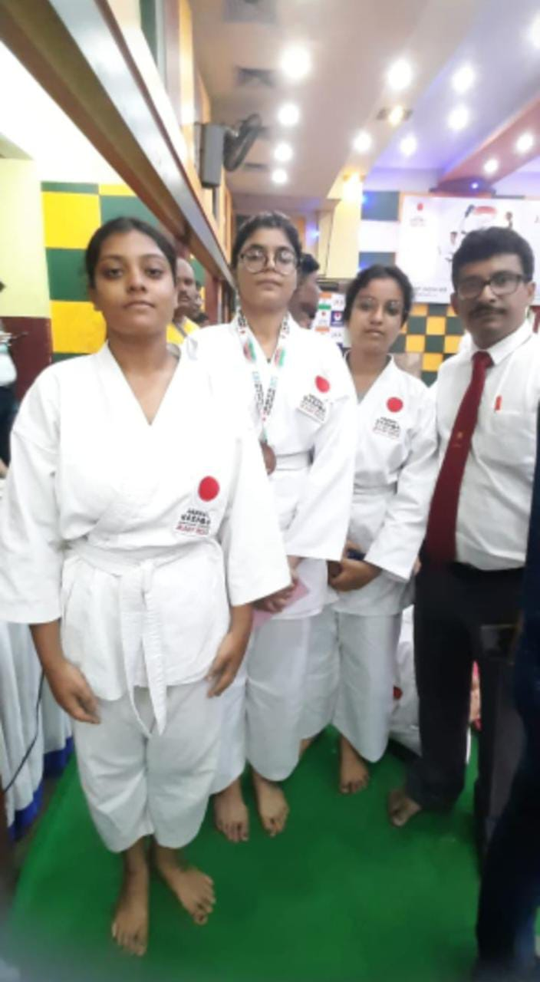
Students Achievements In Different Participatory Program
NAME OF THE STUDENTS | ACHIEVEMENT
Sreyashi Saha 2021 passout | 1st Position in poster Competition in National Science Day at East Calcutta Girls College
Sayanka Bauray 2021 passout | 1st Position in poster Competition in National Science Day at East Calcutta Girls College
Tripti Kumar 2022 passout | 1st Position in poster Competition in National Science Day at East Calcutta Girls College 1st Position in quiz Competition
Siba Akhtari 2022 passout | 1st Position in quiz Competition
Soha Ghosal Pursuing B.SC | Won bronze place JKA TSKC Championship(Self Defense)
Banisha Mondal Pursuing B.SC | Won JKA TSKC Championship (Self Defence)

Slide 5
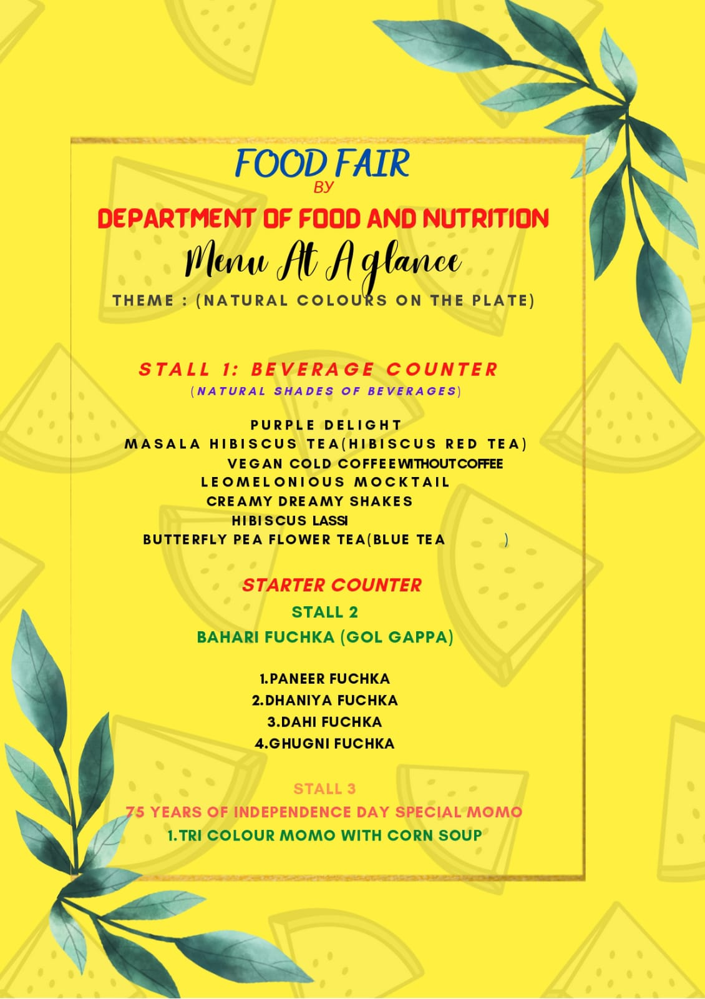
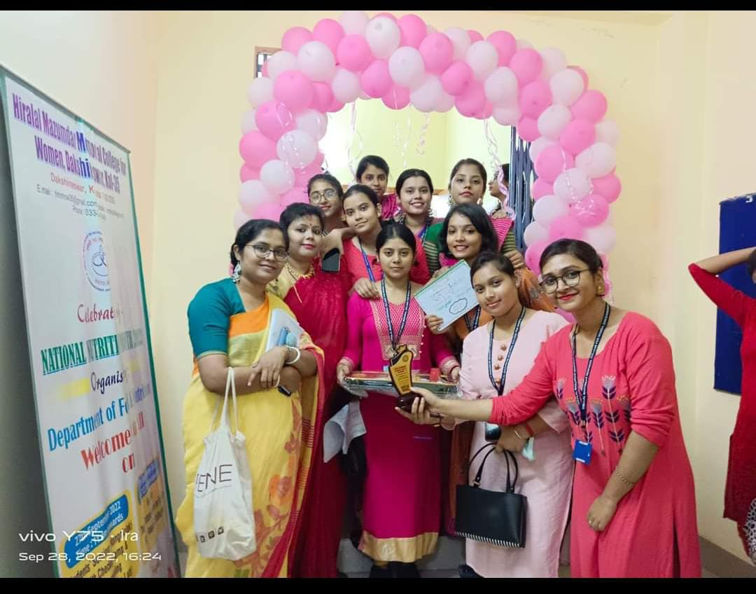
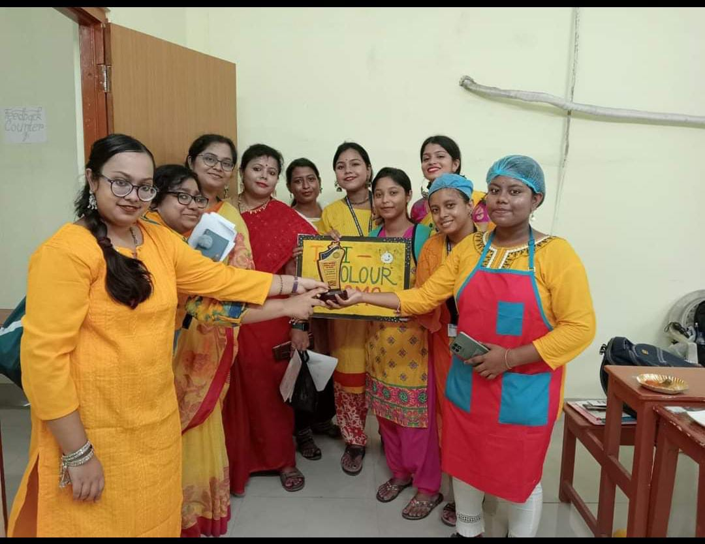
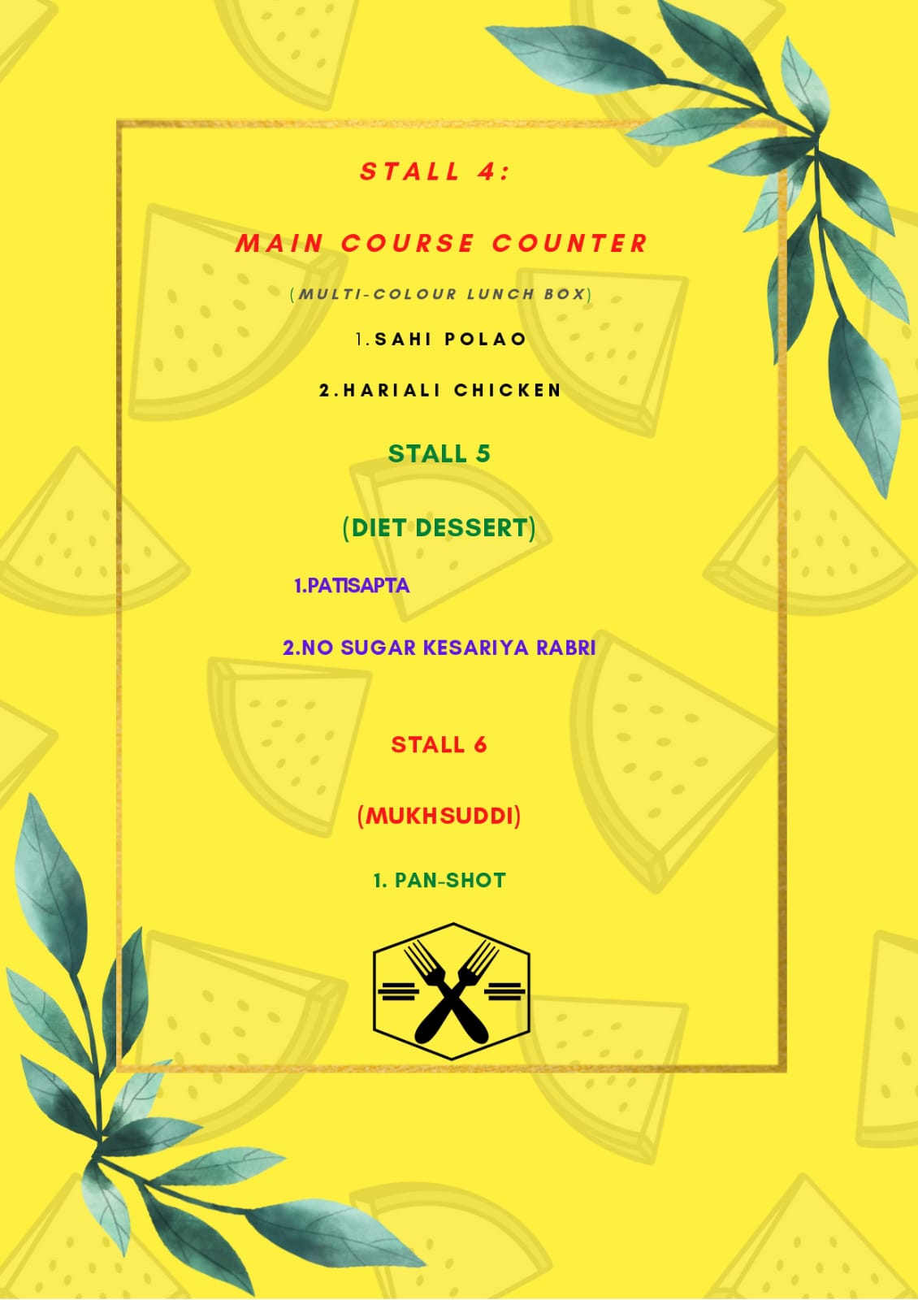
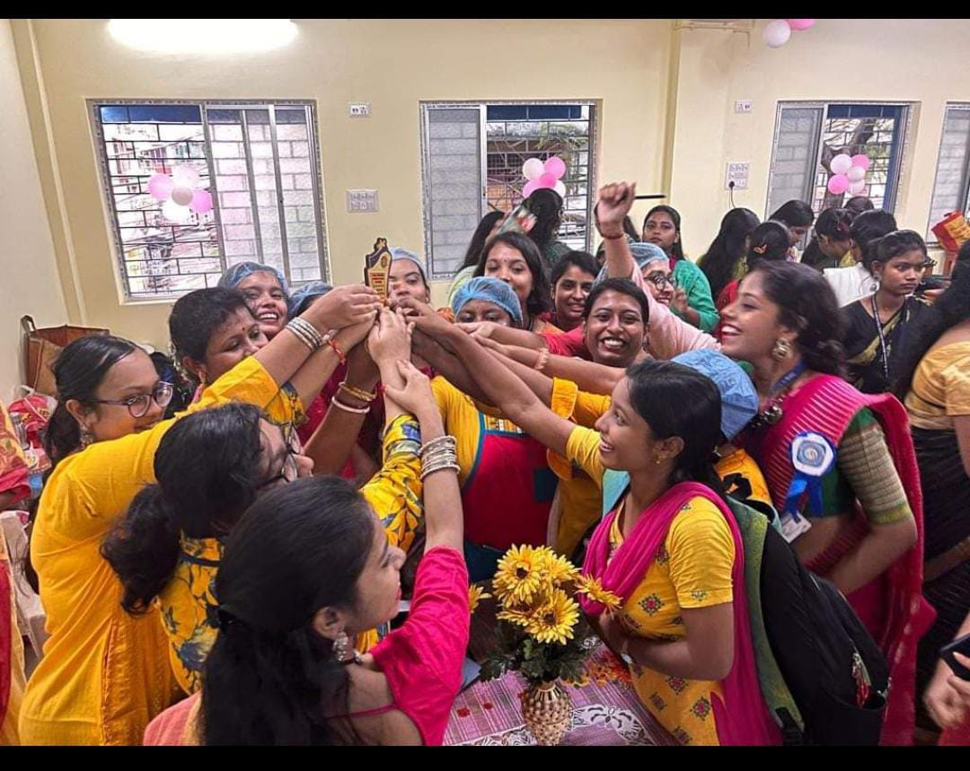
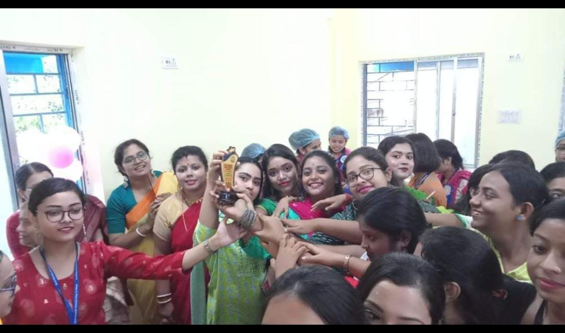
Students Achievements In Different Participatory Program
6TH SEMSTER FOOD AND NUTRITION HONOURS STUDENT GAVE NUTRITIOUS FOOD STALL AT FOOD FAIR ON THE OCASSION OF NATIONAL NUTRITION MONTH 2022 AND WON 1ST 2ND AND 3RD PRIZE AT COLLEGE.

Slide 6
Memorable achievement of students in the recent past
UNIVERSITY RANK HOLDERS OF LAST 5 YEARS
Year | Name of students | Marks % | University rank
2017 | Souradipta Chakraborty | 70.13 | 3rd
 | Swetanjana Ghosh | 68.13 | 5th
2019 | Apurba Roy | 63.88 | 6th
 | Ronita Das | 63.5 | 7th
2020 | Ruma Das | 74.63 | 6th
2021 | Priyanka Ghosh | 81 | 8th
2022 | Ankita Modak | 88.05 | 2nd
 | Debjani Paul | 86.85 | 5th
 | Priti Das | 86.1 | 7th
 | Siba Akhtari | 85.5 | 10th
 | Medhasree Naskar | 85.5 | 10th
Award
https://drive.google.com/file/d/1XvzA8DLxWEUdiZk8jUGISGh5DyhskgZQ/view?usp=drive_link

