Slide 1
CHOLETHIASIS
Soma saha
Assistant professor
Department of food and nutrition
HMM COLLEGE FOR WOMEN

Slide 2
WHAT IS BILE?
A product secretion as well as excretion of liver.
Mostly yellowish green in colour .
Contains water, cholesterol, lecithin, fat, bile salt, bile pigments, inorganic salts.
Doesn't contain any enzymes

Slide 3
Bile acids
Bile acids are produced from cholesterol in hepatocyte
Primary bile acids :- synthesised from cholesterol by endogenous enzymes in hepatocyte. More water soluble.
Cholic acid
Chenodeoxycholic acid
Secondary bile acids :- synthesise from primary bile acids when enters into the intestine by the action of bacterial enzymes. Less water solouble.
Deoxycholic acid
Lithocolic acid

Slide 4
Blie salts
Sodium taurocholate
Sodium glychocolate

Slide 5
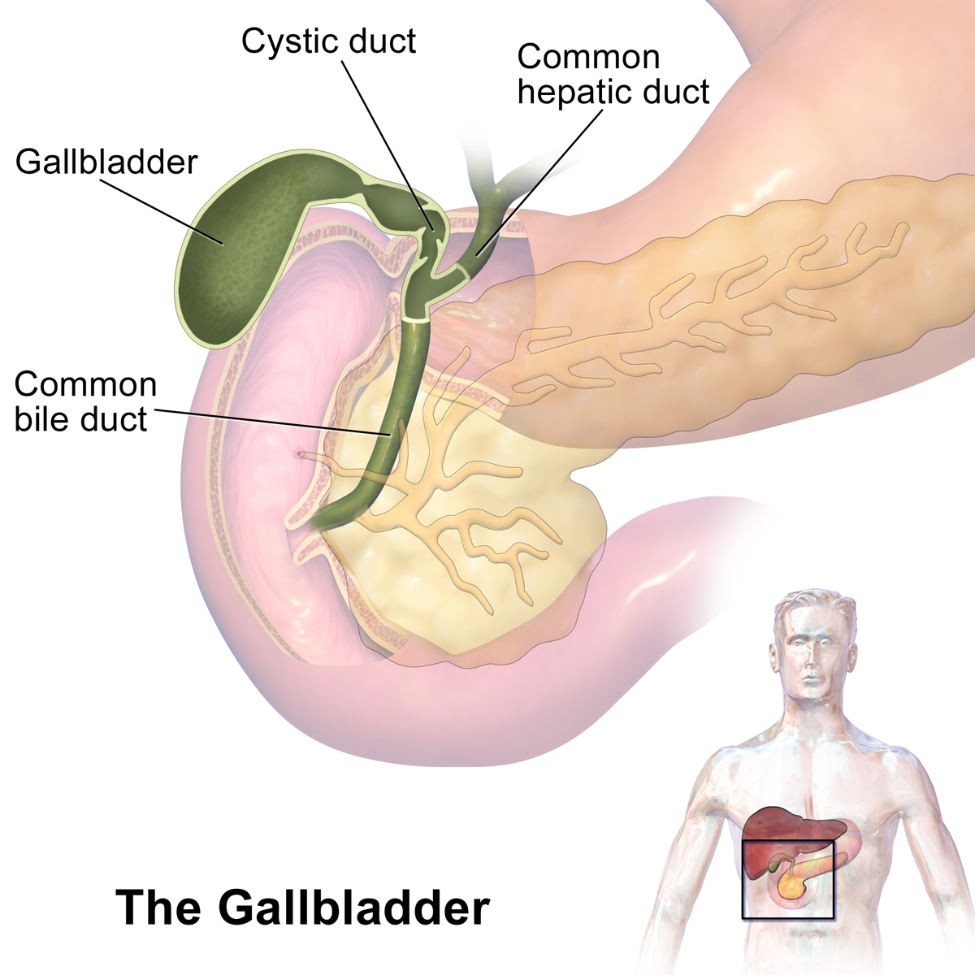
Gall bladder
Structure of gall bladder
FUNCTIONS
Gallbladder stores and releases bile, a fluid made in your liver, to help in fat digestion by emulsification.
CCK contracts gall bladder as fat enters into small intestine. Then spincter of ODII opens and bile from gallbladder inter into the small intestine through common bile duct.

Slide 6
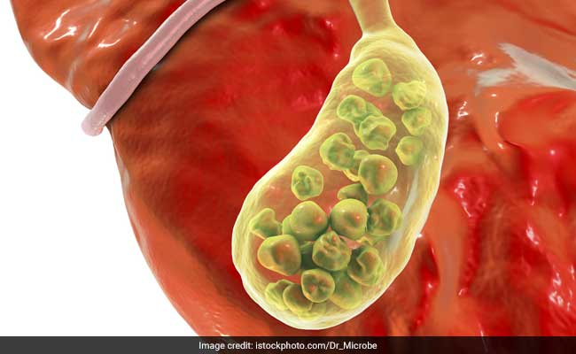
What is gall stones?
Gallstones are pieces of solid material that form in your gallbladder, a small organ under your liver.

Slide 7
Cholethiasis & choledocholithiasis
Presence of gall stones in the gall bladder is called cholelithiasis. May cause no symptoms, patients might be aware of their presence.
When stones slip into the common bile duct producing obstructions , pain , cramps is referred to as Choledocholithiasis.

Slide 8
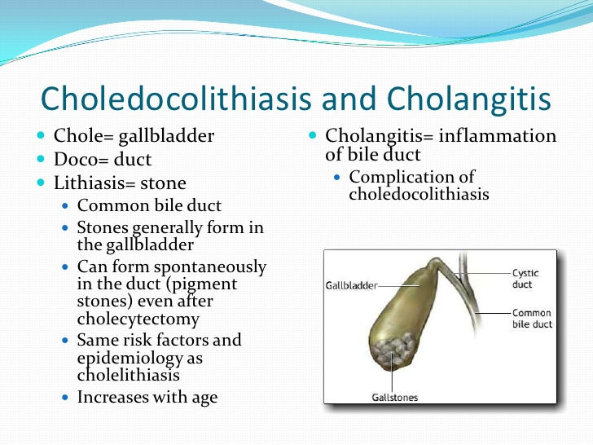
Choledocolithiasis vs cholangitis

Slide 9
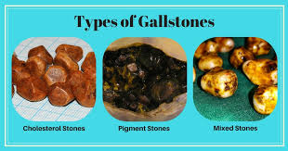
GALL STONE TYPES continues….

Slide 10
Gall stone types
Cholesterol stone
Pigment stones
Made primarily of cholesterol (<70%)
Yellowish green in colour.
Large
Often solitary
Occurs due to increased con of cholesterol.
Risk factors :-4F = female, forty,fertile, fat
Made of bilirubin and calcium salt.
Dark in colour
Small and irregular.
Less then 20% cholesterol.
Risk factors :- haemolysis, liver cirrhosis, sickle cell anaemia

Slide 11
Causes
they might happen when:
There’s too much cholesterol in your bile. Your body needs bile for digestion. It usually dissolves cholesterol. But when it can’t do that, the extra cholesterol might form stones.
There’s too much bilirubin in your bile. Conditions like cirrhosis, infections, and blood disorders can cause your liver to make too much bilirubin.
Your gallbladder doesn’t empty all the way. This can make your bile very concentrated. Incomplete emptying, stagnation of bile.
High intake of fat for a long time.

Slide 12
Risk factors
Rapid weight loss through severe calorie restriction- bilary sludge
Obesity
Female
Increased age
Fasting
Excessive consumption of fatty acids
Contraceptive pills as it contains high levels of oestrogen.
Alteration in bile salt metabolism.

Slide 13
cholecystitis
Inflamation of gall bladder .usually caused by gall stones obstructing the bile duct. wall becomes inflamed, distended, infection can occurs.
Acute cholecystitis :- can occur s without stones in critically ill patients or due to biliary sludge.
Severe pain, nausea, vomiting, jaundice, fever.
Chronic cholecystitis :- appears due to decreased spontaneous contractile activity of the gall bladder and decreased contractile responsiveness to the hormone CCK

Slide 14
SYMPTOMS
Symptoms may include:
Pain in your upper belly, often on the right, just under your ribs
Pain in your right shoulder or back
An upset stomach
Vomiting
Other digestive problems, including indigestion, heartburn, and gas
See your doctor or go to the hospital if you have signs of a serious infection or inflammation:
Belly pain that lasts several hours
Fever and chills
Yellow skin or eyes
Dark urine and light-colored poop

Slide 15
COMPLICATIONS
Gallstones can cause serious problems, including:
Gallbladder inflammation (acute cholecystitis). This happens when a stone blocks your gallbladder so it can’t empty. It causes constant pain and fever. Your gallbladder might burst, or rupture, if you don’t get treatment right away.
Blocked bile ducts. This can cause fever, chills, and yellowing of your skin and eyes (jaundice). If a stone blocks the duct to your pancreas, that organ may become inflamed (pancreatitis).
Infected bile ducts (acute cholangitis). A blocked duct is more likely to get infected. If the bacteria spread to your bloodstream, they can cause a dangerous condition called sepsis.
Gallbladder cancer. It’s rare, but gallstones raise your risk of this kind of cancer.

Slide 16
DIAGNOSIS
Doctor will do a physical exam and might order tests including:
Blood tests. These check for signs of infection or blockage, and rule out other conditions.
Ultrasound. This makes images of the inside of your body.
CT scan. Specialized X-rays let your doctor see inside your body, including your gallbladder.
Magnetic resonance cholangiopancreatography (MRCP). This test uses a magnetic field and pulses of radio wave energy to make pictures of the inside of your body, including your liver and gallbladder.
Cholescintigraphy (HIDA scan). This test can check whether your gallbladder squeezes correctly. Your doctor injects a harmless radioactive material that makes its way to the organ. A technician can then watch its movement.
Endoscopic retrograde cholangiopancreatography (ERCP). Your doctor runs a tube called an endoscope through your mouth down to your small intestine. They inject a dye so they can see your bile ducts on a camera in the endoscope. They can often take out any gallstones that have moved into the ducts.
Endoscopic ultrasound. This test combines ultrasound and endoscopy to look for gallstones.
SOURCE:-https://www.webmd.com/

Slide 17
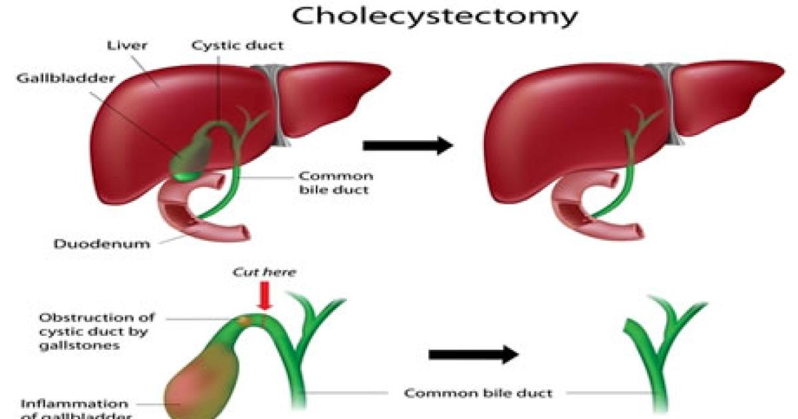
TREATMENT

Slide 18
TREATMENT
Laparoscopic cholecystectomy. This is the most common surgery for gallstones. Your doctor passes a narrow tube called a laparoscope into your belly through a small cut. It holds instruments, a light, and a camera. They take out your gallbladder through another small cut. You’ll usually go home the same day.
Open cholecystectomy. Your doctor makes bigger cuts in your belly to remove your gallbladder. You’ll stay in the hospital for a few days afterward.
If gallstones are in your bile ducts, your doctor may use ERCP to find and remove them before or during surgery.
If you have another medical condition and your doctor thinks you shouldn't have surgery, they might give you medication instead. Chenodiol (Chenodol) and ursodiol (Actigall, Urso 250, Urso Forte) dissolve cholesterol stones. They can cause mild diarrhea.
You may have to take the medicine for years to totally dissolve the stones

Slide 19
Preventing Gallstones
Some lifestyle changes might lower your risk of gallstones.
Eat a healthy diet that's high in fiber and good fats, like fish oil and olive oil. Avoid refined carbs, sugar, and unhealthy fats.
Get regular exercise. Aim for at least 30 minutes, 5 days a week.
Avoid diets that make you lose a lot of weight in a short time.
If you’re a woman at high risk of gallstones (for example, because of your family history or another health condition), talk to your doctor about whether you should avoid the use of hormonal birth control.

Slide 20
DIETARY PRINCIPLES
LOW CALORIE
Normal carbohydrate with low simple su
MODERATE PROTEIN MAINLY VEG PROTEIN
RESTRICTED FAT AND FAT CONTAINING FOOD.
VIT MINERAL SUPPLEMENTATION.
ADEQUATE WATER INTAKE.
SIMPLE DIET.

