Slide 1
Dr. Madhushri Das
Assistant Professor, Dept. Of Botany
HMMC for Women, Dakshineswar
Semester-II
Core Course IV: Archegoniate Course Code: BOTACOR04T
Unit 6: Gymnosperms- Part-I

Slide 2
GENERAL CHARACTERS OF GYMNOSPERMS
Introduction:
The sporophyte is usually arborescent (resembling a tree in growth or appearance) comprising of large or small woody trees or shrubs. Few may be lianas or climbers. Most gymnosperms are evergreen but some are deciduous such as Larix sp. and Taxodium sp.

Slide 3
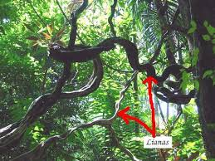
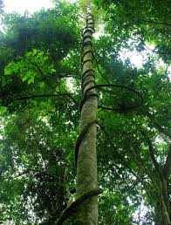
Gymnosperms features:
(A xerophyte (from Greek ξηρός xeros dry, φυτόν phuton plant) is a species of plant that has adaptations to survive in an environment with little liquid water, such as a desert or an ice- or snow-covered region in the Alps or the Arctic.
Popular examples of xerophytes are cacti, pineapple and some Gymnosperm plants.).

Slide 4
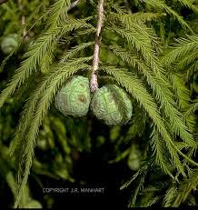
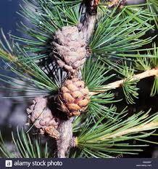
Gymnosperms features:
Taxodium sp.
Larix sp.

Slide 5
Gymnosperms features:
The plants are mostly xerophytes.
The plant body is sporophyte and is differentiated into root, stem and leaves.

Slide 6
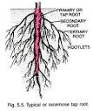
Gymnosperms features:
The plants have a long lasting tap root system.
TAPROOT SYSTEM

Slide 7
Gymnosperms features:
The vascular cylinder is di-to polyarch, xylem exarch.
Main elements of xylem are tracheids but in Gnetum and Ephedra vessels are also present. Phloem is composed of sieve cells and lacks companion cells.

Slide 8
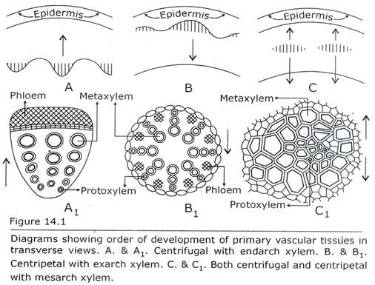
Gymnosperms features:

Slide 9
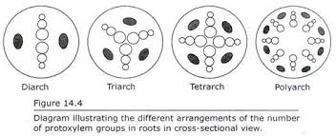
Gymnosperms features:

Slide 10
Gymnosperms features:
Some forms exhibit additional symbiotic relationship between roots and algae in coralloid roots (Cycas sp.) and between roots and fungi in mycorrhizic roots (Pinus sp).

Slide 11
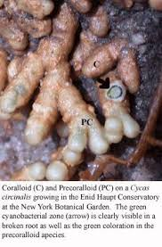
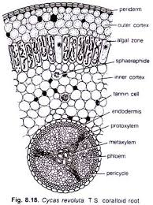
Coralloid roots (Cycas sp.)

Slide 12
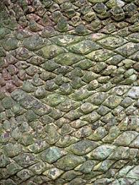
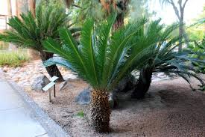
Gymnosperms features:
The stem is aerial, erect and branched or unbranched (Cycas sp.) with leaf scars.

Slide 13
Gymnosperms features:
In conifers two types of branches namely branches of limited growth (Dwarf shoot) and Branches of unlimited growth (Long shoot) is present.

Slide 14
Leaves are dimorphic, foliage and scale leaves are present. Foliage leaves are green, photosynthetic and borne on branches of limited growth. They show xerophytic features.

Slide 15
Gymnosperms features:
Secondary growth is present. The wood may be Manoxylic (Porous, soft, more parenchyma with wide medullary ray –Cycas sp.) or Pycnoxylic (compact with narrow medullary ray-Pinus sp.).

Slide 16
Gymnosperms features:
They are heterosporous. The plant may be monoecious (Pinus sp.) or dioecious (Cycas sp.).
Microsporangia and Megasporangia are produced on Microsporophyll and Megasporophyll respectively.
Male and female cones are produced.

Slide 17
Gymnosperms features:
Anemophilous pollination (wind-pollinated) is present.
Fertilization is siphonogamous (a condition in plants in which pollen tubes are developed for the transfer of the male cells to the eggs. Usually the seed plants are siphonogamous, while in the lower plants the male cells usually swim to the eggs) and pollen tube helps in the transfer of male nuclei.

Slide 18
Gymnosperms features:
Polyembryony (presence of many embryo)­ is Present. The naked ovule develops into seed.
The endosperm is haploid and develop before fertilization.

Slide 19
Gymnosperms features:
The life cycle shows alternation of generation. The sporophytic phase is dominant and gametophytic phase is highly reduced.

Slide 20
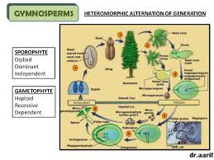
Heteromorphic alternation of generation in Gymnosperms

Slide 21
Gymnosperms resemble with angiosperms in the following features
Presence of well organised plant body which is differentiated into roots, stem and leaves.
Presence of cambium in gymnosperms as in dicotyledons.
Flowers in Gnetum resemble to the angiosperm male flower. The Zygote represent the first cell of sporophyte.

Slide 22
Gymnosperms resemble with angiosperms in the following features
Presence of integument around the ovule.
Both plant groups produce seeds.
Pollen tube helps in the transfer of male nucleus in both.
Presence of Eustele.

Slide 23
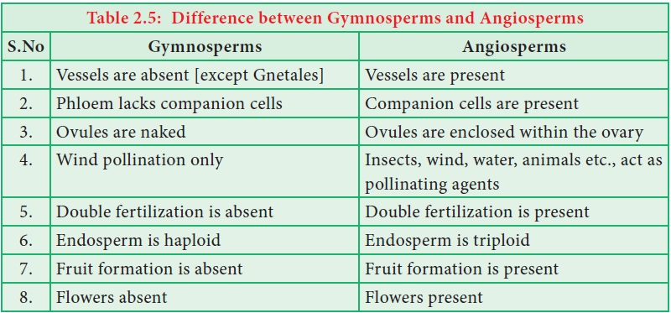
Difference between angiosperms and gymnosperms

