Slide 1
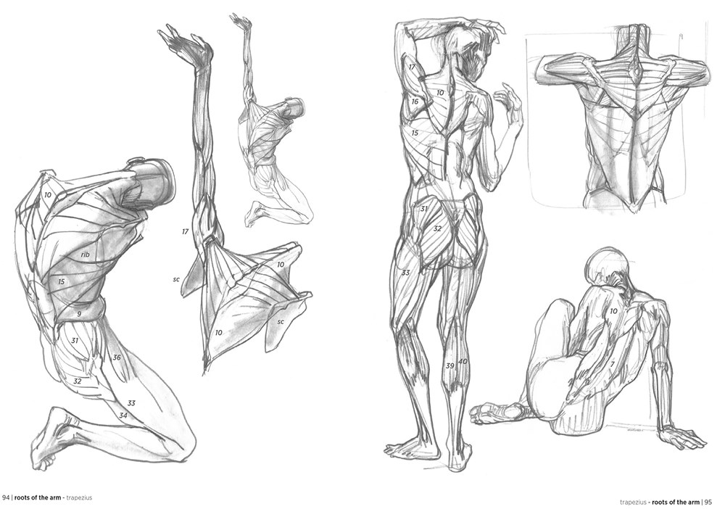
Muscular tissue in general develops from the mesoderm of the embryo but the muscles of the iris of the eye and myoepithelial cells of the salivary, mammary and sweat glands arise from the ectoderm of the embryo. Myo, sarco and motor are concerned with muscles. This tissue constitutes the muscles, made up of cells, which are in the form of contractile fibres varying in lengths. The fibres are bound together by connective tissues but they have no intercellular substance.
Myoblasts give rise to muscle fibres. Myocytes (= sarcocytes) are muscle cells. Each fibre consists of fine fibrils called myofibrils, present in the cytoplasm known as sarcoplasm. Sometimes the muscle fibre is externally covered by a membrane, termed as sarcolemma.
Contractility : The cells of muscular tissue can shorten considerably and return to the original relaxed state in a definite direction.
Electrical excitability : due to the energy stored in the electrical potential difference across the plasma membrane.
ZOOACOR06T SEMESTER IIIH
Unit 4: Muscular System
Types of Muscle Tissue:
1. Striped or striated or skeletal or voluntary muscles.
2. Un-striped or non-striated or visceral or smooth or involuntary muscles.
3. Cardiac muscles.

Slide 2
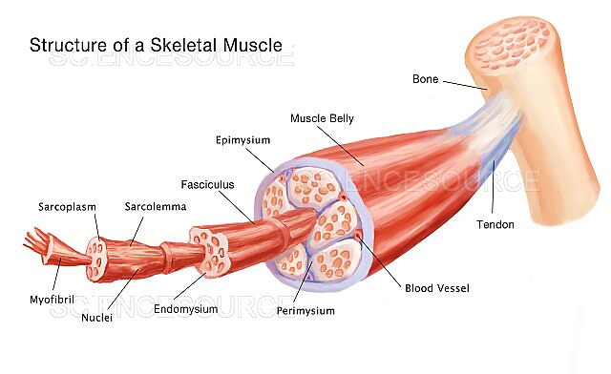
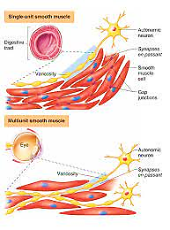
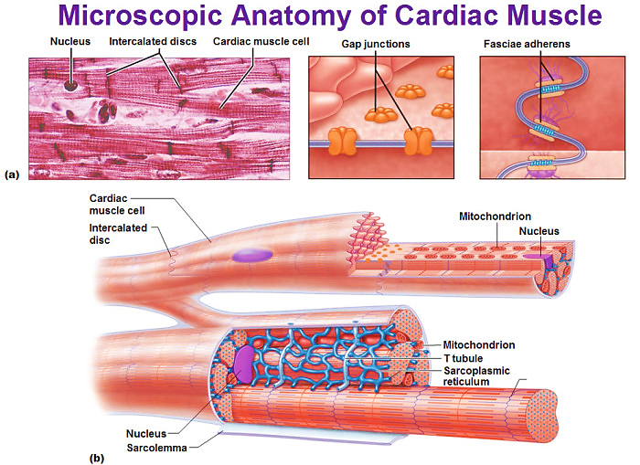
Each of these tissues is composed of cells called muscle fi­bers, which contain cytoplasmic filaments of actin, myosin, and other proteins responsible for the con­tractile nature of muscle. The filaments are arranged differently in each of the tissue types. The arrange­ment is most highly organized in striated muscle, and it is this type of muscle tissue that has been most ex­tensively studied.
During embryonic de­velopment, the muscle fiber is formed by the end-to- end fusion of many ceils into a continuous tube-like structure.
This explains why striated muscle fibers are such long cells and are multinucleate. The plasma membrane of the muscle fiber is called the sarcolemma; in addition to its exceptional length, the sarcolemma is characterized by numerous pore like invag­inations that extend into the sarcoplasm (cytoplasm) at right angles to the long axis of the cell.

Slide 3
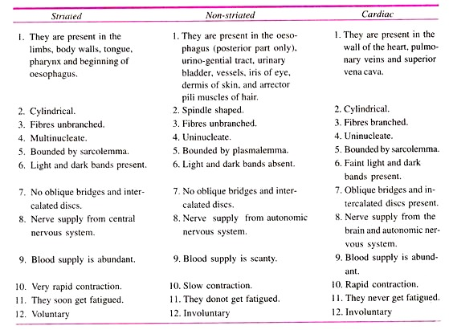

Slide 4
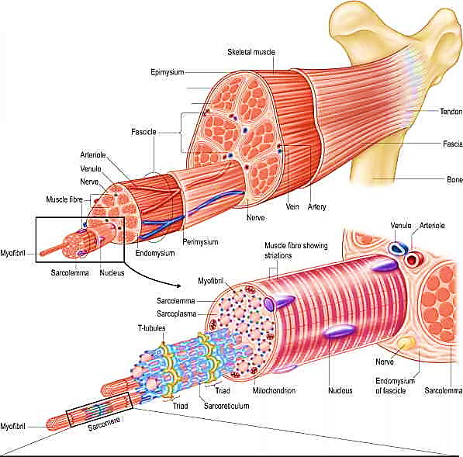
The skeletal (voluntary and striated) muscle fibres are multinucleated cylindrical structures having a clear display of longitudinal and cross-striations. This muscular tissue is responsible for voluntary movement of the living system. It can perform works of rapid, powerful contraction as well as that of prolonged slow sus­tained tonic contraction. attached to osseous tissues (bones)
In the fresh state the human skeletal muscle is pink in colour due to the presence of muscle pigments and high vascularity. Due to variation in colour there are red and white or pale muscles.
The skeletal muscle is developed from the solid mass of the mesoderms (myotomes) except the muscle of the head which is developed from the loose mesenchyme.At the junctional point, the fibre of the tendon is affixed to the sarcolemma of the muscle fibres which is again surrounded by areolar tissue to strengthen the junction.
Each muscle fibre (cell) consists of multiple muscle fibrils or myofibrils. The whole muscle bulk is divided into smaller bundles, the fasciculi, bounded by the perimysium, the connective tissue septa; Epimysium, the connective tissue coat, is the outer most covering for each whole skeletal muscle bulk. A blood capillary is seen near each muscle fibre along with the endomysium.

Slide 5
The skeletal muscle fibres are cylindrical, elongated cells with multiple nuclei.
The extent of the muscle fibres in the bulk may be from:
(i) One end to the other,
(ii) One end to somewhere at midway, or
(iii) Both the ends within the muscle having no attachments with either side. The length and breadth of the muscle fibre vary from 1.0 to 4.0 mm and 0.01 mm (10µ) to 0.1 mm (100µ) respectively.
Though the fibres of various sizes in the same muscle yet there is some correlation between the amount of work to be performed by the muscle and the thickness and size of the fibres. The thickness also varies with the degree of nourishment of the individual. The growth of the muscle on systematic exercise is due to increase in total fibre volume and improvement of blood supply and not due to increase of fibre number.
The transparent cell wall (Fig. 1.65) of the muscle fibre is named as Sarcolemma. Under light microscope it is visible when fresh muscle fibres are teased. Electron micrograph shows that it is made up not only of the plasmalemma but also of an extrinsic coat of amorphous material, similar to the basement membrane.
This amorphous layer is pierced and encircled by reticular fibres. The plasmalemma is of same structure as that of any other cell, i.e., two protein layers enclosing a lipid one with a thickness of 100 A. Inside the plasmalemma, elongated multiple nuclei and transversely striated myofibrils (bundles of myofilaments) are embedded in the sarcoplasm (in many respects the cytoplasm of any other cell).
The sarcoplasm contains other constituents as that of any other cell, e.g., numerous mitochondria (sometimes called sarcosomes), a small Golgi apparatus near each nucleus, myoglobin (protein pigment)., lipid, glycogen, sarcoplasmic reticulum (endoplasmic reticulum in case of other-tissue), etc. Fibres which are richer in sarcoplasm are darker in colour and vice versa.
The characteristic features of skeletal muscle, the alternate light and dark shades (trans­verse striations) and thick longitudinal strands can be studied with light microscope. Electron micrography reveals that the longitudinal striation is due to the presence of myofibrils of different thickness whereas the transverse striation is due to the presence of alternate light and dark segments of longitudinally arranged ele­ments.
In cross-section, myofibrils appear as fine dots either distributed uniformly or in a group of polygonal areas and are separated from adjacent bundles by clear sarcoplasm. The separated myofibrils by the sarco­plasmic areas are known as fields of Cohnheim.The dark band is doubly refractive (anisotropic) when studied under polarized light, hence the name A band (sometimes called Q-band). The light band is monorefractive (isotropic) under polarized.
The Z-line is made of a membrane extending across the myofibrils. The myofibrils are tortuous at these Z-lines. The portion enclosed by two adjacent Z-lines of a myofibril is considered as the contractile unit and is named as sarcomere. It extends 2µ to 3µ in length. In certain exceptional preparations, central portion of the A-band is paler in colour and called the H-band (Hensen’s line). At the midpoint of the H-band, i.e., also of the A-band, there is a narrow dark line, M-line or M-band, where the myosin filaments are thickened. The myosin and actin filaments are overlapped at the peripheral dark portion of the A-band, which is named as the O-band. On both sides of the Z-line, somewhere in the midregion of the I-band there is a comparatively darker thin transverse line-the N-line.

Slide 6
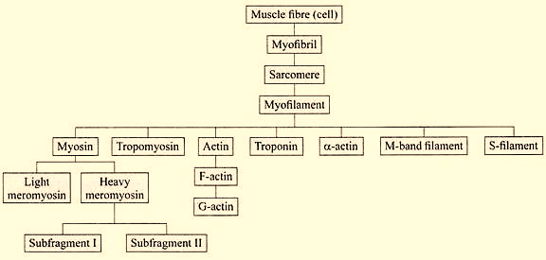
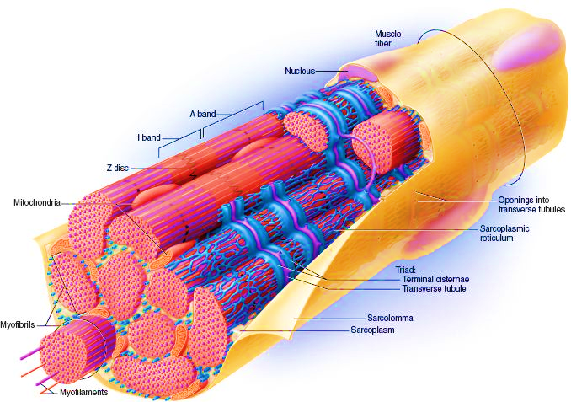
Micro-anatomical organization of the muscle fibre has been presented schematically:

